Slide 1


Noida Institute of Engineering and Technology, Greater Noida
Expectations and Probability Distribution
Unit: IV
Subject Name: Eng. Mathematics IV
Subject code: AAS0402
Dr. Kunti Mishra
Department of
Mathematics
B Tech 4th Sem

Slide 2

Brief Introduction of Faculty
Dr. Kunti Mishra
Assistant Professor
Department of Mathematics
Qualifications :
M.Sc.(Maths), M. Tech.(Gold Medalist) in Applied and Computational Mathematics, Ph.D
Ph.D. Thesis : Some Investigations in Fractal Theory
Total Number of Research Papers:15
Area of Interests: Fixed Point Theory, Fractals
Teaching Experience: 9 years

Slide 3

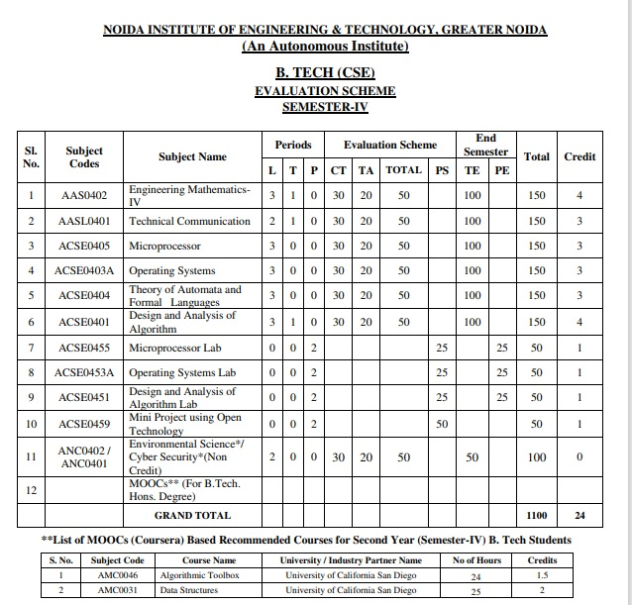
Evaluation Scheme

Slide 4
Syllabus
Unit-I (Statistical Techniques-I)
Introduction: Measures of central tendency: Mean, Median, Mode, Moment, Skewness, Kurtosis, Curve Fitting ,Method of least squares, Fitting of straight lines, Fitting of second degree parabola, Exponential curves ,Correlation and Rank correlation, Linear regression, nonlinear regression and multiple linear regression
Unit-II (Statistical Techniques-II)
Testing a Hypothesis, Null hypothesis, Alternative hypothesis, Level of significance, Confidence limits, p-value, Test of significance of difference of means, Z-test, t-test and Chi-square test, F-test, ANOVA: One way and Two way. Statistical Quality Control (SQC), Control Charts, Control Charts for variables (Mean and Range Charts), Control Charts for Variables ( p, np and C charts).

Slide 5
Syllabus
Unit III (Probability and Random Variable)
Random Variable: Definition of a Random Variable, Discrete Random Variable, Continuous Random Variable, Probability mass function, Probability Density Function, Distribution functions.
Multiple Random Variables: Joint density and distribution Function, Properties of Joint Distribution function, Marginal density Functions, Conditional Distribution and Density, Statistical Independence, Central Limit Theorem (Proof not expected).
Unit IV (Expectations and Probability Distribution)
Operation on One Random Variable – Expectations: Introduction, Expected Value of a Random Variable, Mean, Variance, Moment Generating Function, Binomial, Poisson, Normal, Exponential distribution.

Slide 6
Syllabus
Unit V (Wavelets and applications and Aptitude-IV)
Wavelet Transform, wavelet series. Basic wavelets (Haar/Shannon/Daubechies), orthogonal wavelets, multi-resolution analysis, reconstruction of wavelets and applications.
Number System, Permutation & Combination, Probability, Function, Data Interpretation, Syllogism.

Slide 7
Branch Wise Application
Data Analysis
Artificial intelligence
Network and Traffic modeling

Slide 8
Course Objectives
The objective of this course is to familiarize the students with statistical techniques. It aims to present the students with standard concepts and tools at an intermediate to superior level that will provide them well towards undertaking a variety of problems in the discipline.
The students will learn:
Understand the concept of correlation, moments, skewness and kurtosis and curve fitting.
Apply the concept of hypothesis testing and statistical quality control to create control charts.
Remember the concept of probability to evaluate probability distributions.
Understand the concept of Mathematical Expectations and Probability Distribution.
Remember the concept of Wavelet Transform and Solve the problems of Number System, Permutation & Combination, Probability, Function, Data Interpretation, Syllogism.

Slide 9
Course Outcomes
CO1: Understand the concept of correlation, moments, skewness and kurtosis and curve fitting.
CO2: Apply the concept of hypothesis testing and statistical quality control to create control charts.
CO3: Remember the concept of probability to evaluate probability distributions
CO4: Understand the concept of Mathematical Expectations and Probability Distribution
CO5: Remember the concept of Wavelet Transform and Solve the problems of Number System, Permutation & Combination, Probability, Function, Data Interpretation, Syllogism.

Slide 10
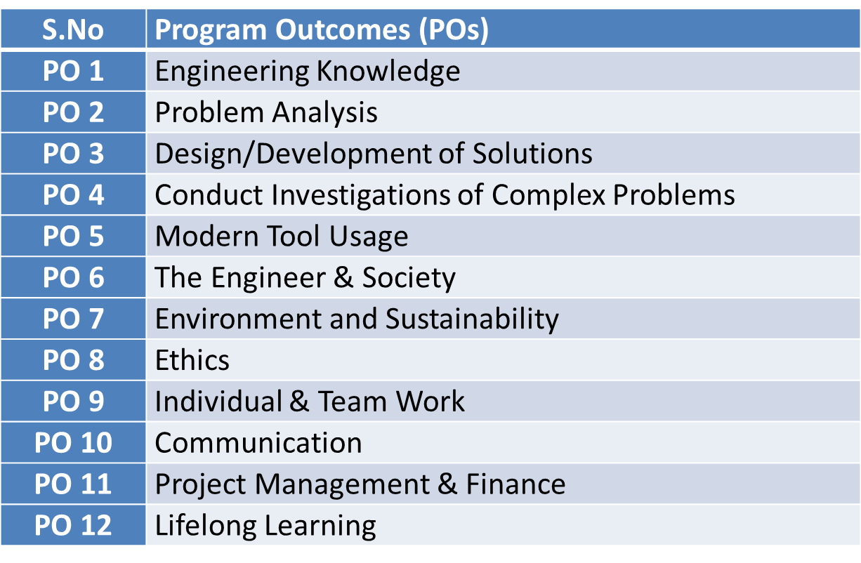
Program Outcomes

Slide 11
PSOs
PSO | Program Specific Outcomes(PSOs)
PSO1 | The ability to identify, analyze real world problems and design their ethical solutions using artificial intelligence, robotics, virtual/augmented reality, data analytics, block chain technology, and cloud computing
PSO2 | The ability to design and develop the hardware sensor devices and related interfacing software systems for solving complex engineering problems.
PSO3 | The ability to understand inter disciplinary computing techniques and to apply them in the design of advanced computing.
PSO4 | The ability to conduct investigation of complex problem with the help of technical, managerial, leadership qualities, and modern engineering tools provided by industry sponsored laboratories.

Slide 12
CO-PO Mapping
Sr. No | Course Outcome | PO1 | PO2 | PO3 | PO4 | PO5 | PO6 | PO7 | PO8 | PO9 | PO10 | PO11 | PO12
1 | CO1 | H | H | H | H | L | L | L | L | L | L | L | M
2 | CO2 | H | H | H | H | L | L | L | L | L | L | M | M
3 | CO3 | H | H | H | H | L | L | L | L | L | L | M | M
4 | CO4 | H | H | H | H | L | L | L | L | L | L | L | M
5 | CO5 | H | H | H | H | L | L | L | L | L | L | M | M
*L= Low *M= Medium *H= High

Slide 13
CO-PSO Mapping
CO | PSO1 | PSO2 | PSO3 | PSO4
CO.1 | H | L | M | L
CO.2 | L | M | L | M
CO.3 | M | M | M | M
CO.4 | H | M | M | M
CO.5 | H | M | M | M
*L= Low *M= Medium *H= High

Slide 14
Program Educational Objectives(PEOs)
PEO-1: To have an excellent scientific and engineering breadth so as to comprehend, analyze, design and provide sustainable solutions for real-life problems using state-of-the-art technologies.
PEO-2: To have a successful career in industries, to pursue higher studies or to support entrepreneurial endeavors and to face the global challenges.
PEO-3: To have an effective communication skills, professional attitude, ethical values and a desire to learn specific knowledge in emerging trends, technologies for research, innovation and product development and contribution to society.
PEO-4: To have life-long learning for up-skilling and re-skilling for successful professional career as engineer, scientist, entrepreneur and bureaucrat for betterment of society.

Slide 15
Result Analysis
Branch | Semester | Sections | No. of enrolled Students | No. Passed Students | % Passed
CS | IV | A | 67 | 67 | 100
IOT | IV | A | 49 | 45 | 91.83%

Slide 16
End Semester Question Paper Template
Link:100 Marks Question Paper Template.docx

Slide 17
Prerequisite and Recap (CO3)
Knowledge of Maths 1 B.Tech.
Knowledge of Maths 2 B.Tech.
Knowledge of Permutation and Combination.

Slide 18
Brief Introduction about the Subject with Videos (CO3)
We will discuss properties of complex function (limits, continuity, differentiability, Analyticity and integration)
In 3rd module we will discuss application of partial differential equations
In 4th module we will discuss numerical methods for solving algebraic equations, system of linear equations, definite integral and 1st order ordinary differential equation.
In 5th module we will discuss aptitude part.
https://youtu.be/iUhwCfz18os
https://youtu.be/ly4S0oi3Yz8
https://youtu.be/f8XzF9_2ijs

Slide 19
Unit Objectives (CO3)
A basic knowledge of random variables.
The student is able to reflect developed mathematical methods in probability and random variable.
Understand the concept of random variable.
4. To explore the key properties: such as PMF, PDF etc.

Slide 20
End Semester Question Paper Template
Link:
100 Marks Question Paper Template.docx

Slide 21
Result Analysis
Branch | Semester | Sections | No. of enrolled Students | No. Passed Students | % Passed
CS | IV | A | 67 | 67 | 100
IOT | IV | A | 49 | 45 | 91.83%

Slide 22
Unit Content
Expectations: Introduction
Expected Value of a Random Variable
Mean,
Variance,
Moment Generating Function,
Binomial,
Poisson,
Normal,
Exponential distribution.

Slide 23
Topic objective (CO4)
Mathematical expectation
To get a general understanding of the mathematical expectation of a discrete random variable.
To learn and be able to apply a shortcut formula for the variance of a discrete random variable.
To be able to calculate the mean and variance of a linear function of a discrete random variable.

Slide 24
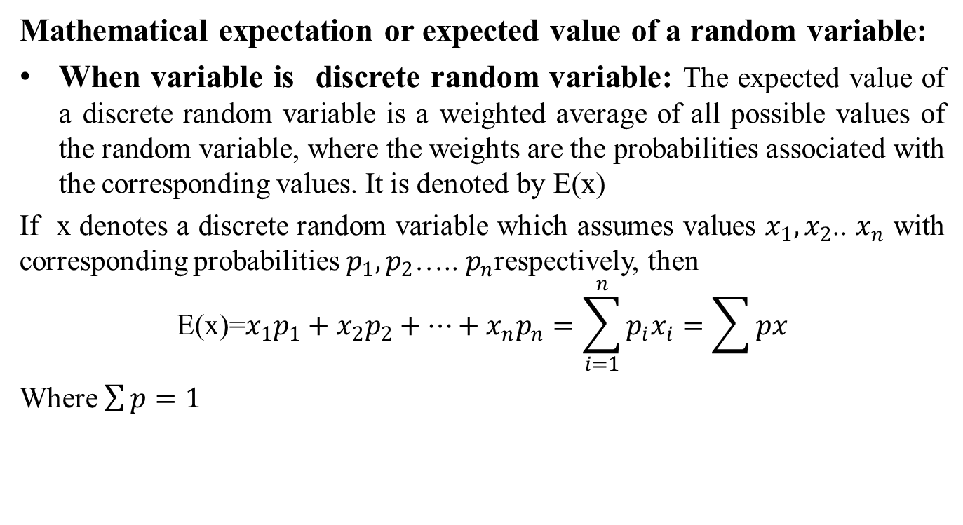
Mathematical expectation(CO4)
Mathematical expectation or expected value of a random variable:
When variable is discrete random variable: The expected value of a discrete random variable is a weighted average of all possible values of the random variable, where the weights are the probabilities associated with the corresponding values. It is denoted by E(x)
If x denotes a discrete random variable which assumes values $x_{1},x_{2}$.. $x_{n}$ with corresponding probabilities $p_{1},p_{2}$….. $p_{n}$respectively, then
$$\text{E}\text{(}\text{x}\text{)=}x_{1}p_{1}+{x_{2}p}_{2}+…+x_{n}p_{n}=\sum_{i=1}^{n}{p_{i}x_{i}}=\sum{px}$$
Where $\sum{p}=1$

Slide 25
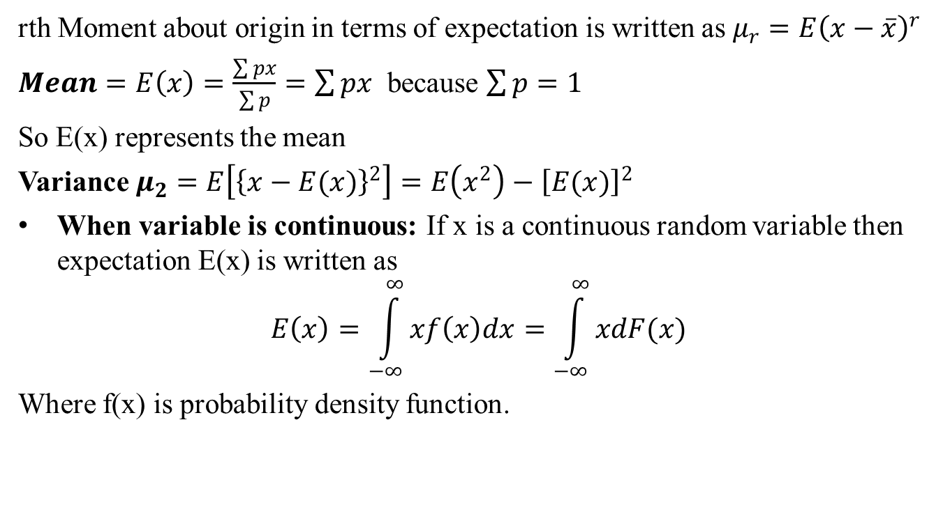
Mathematical expectation(CO4)
rth Moment about origin in terms of expectation is written as $μ_{r}=E{\left(x−\overline{x}\right)}^{r}$
$Mean=E\left(x\right)=\frac{\sum{px}}{\sum{p}}=\sum{px}$ because $\sum{p=1}$
So E(x) represents the mean
Variance $μ_{2}=E\left[{\left\{x−E(x)\right\}}^{2}\right]=E\left(x^{2}\right)−{\left[E(x)\right]}^{2}$
When variable is continuous: If x is a continuous random variable then expectation E(x) is written as
$$E\left(x\right)=\int_{−∞}^{∞}{xf\left(x\right)dx=\int_{−∞}^{∞}{xdF(x)}}$$
Where f(x) is probability density function.

Slide 26
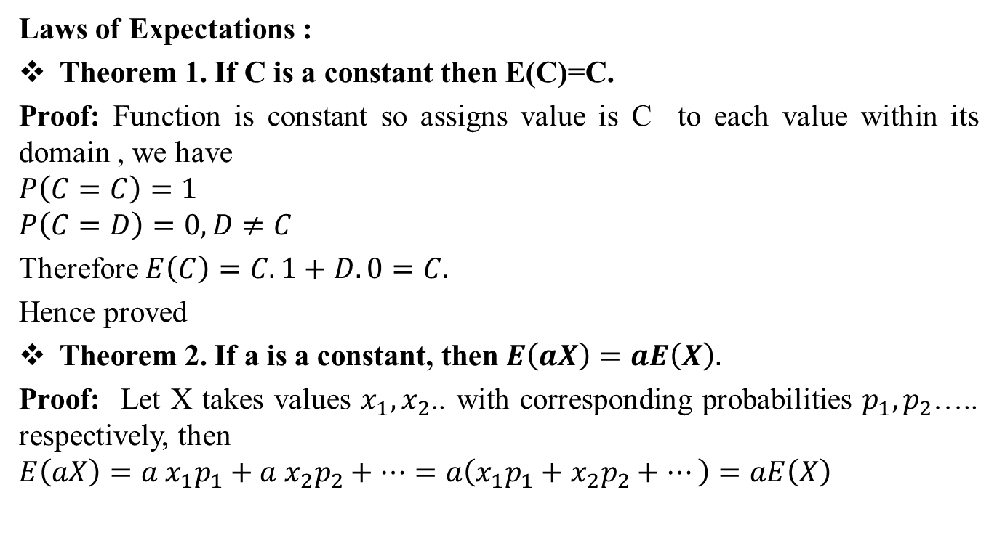
Mathematical expectation(CO4)
Laws of Expectations :
Theorem 1. If C is a constant then E(C)=C.
Proof: Function is constant so assigns value is C to each value within its domain , we have
$$P\left(C=C\right)=1$$
$$P\left(C=D\right)=0, D≠C$$
Therefore $E\left(C\right)=C.1+D.0=C.$
Hence proved
Theorem 2. If a is a constant, then $E\left(aX\right)=aE\left(X\right).$
Proof: Let X takes values $x_{1},x_{2}$.. with corresponding probabilities $p_{1},p_{2}$….. respectively, then
$$E\left(aX\right)={a x}_{1}p_{1}+{a{ x}_{2}p}_{2}+…=a\left(x_{1}p_{1}+{x_{2}p}_{2}+…\right)=aE\left(X\right)$$

Slide 27
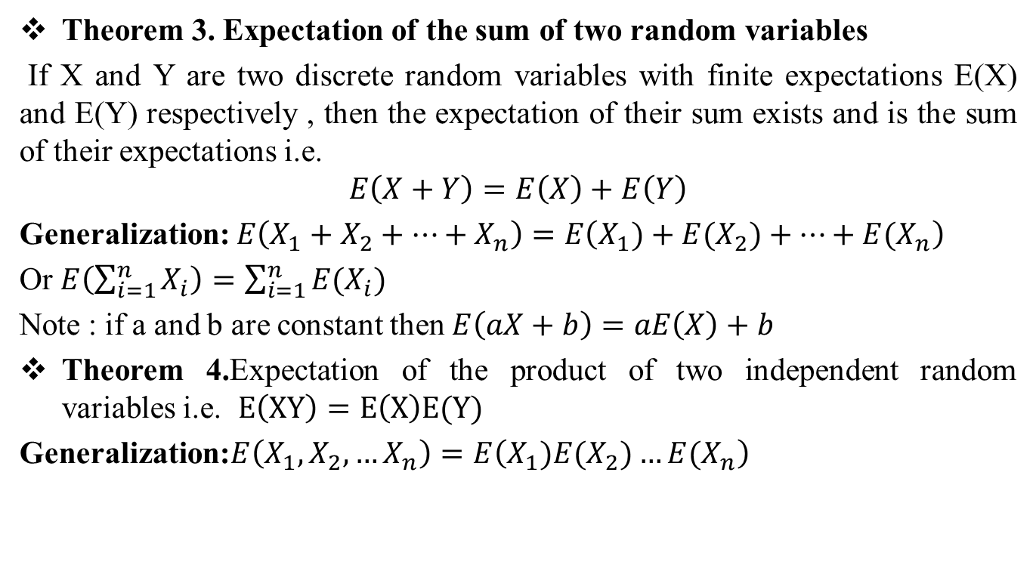
Mathematical expectation(CO4)
Theorem 3. Expectation of the sum of two random variables
If X and Y are two discrete random variables with finite expectations E(X) and E(Y) respectively , then the expectation of their sum exists and is the sum of their expectations i.e.
$$E\left(X+Y\right)=E\left(X\right)+E\left(Y\right)$$
Generalization: $E\left(X_{1}+X_{2}+…+X_{n}\right)=E\left(X_{1})+{E(X}_{2})+…+E(X_{n}\right)$
Or $E\left(\sum_{i=1}^{n}{X_{i}}\right)=\sum_{i=1}^{n}{E(X_{i})}$
Note : if a and b are constant then $E\left(aX+b\right)=aE\left(X\right)+b$
Theorem 4.Expectation of the product of two independent random variables i.e. $E\left(XY\right)=E\left(X\right)E(Y)$
Generalization:$E\left(X_{1},X_{2},…X_{n}\right)=E\left(X_{1}){E(X}_{2})…E(X_{n}\right)$

Slide 28
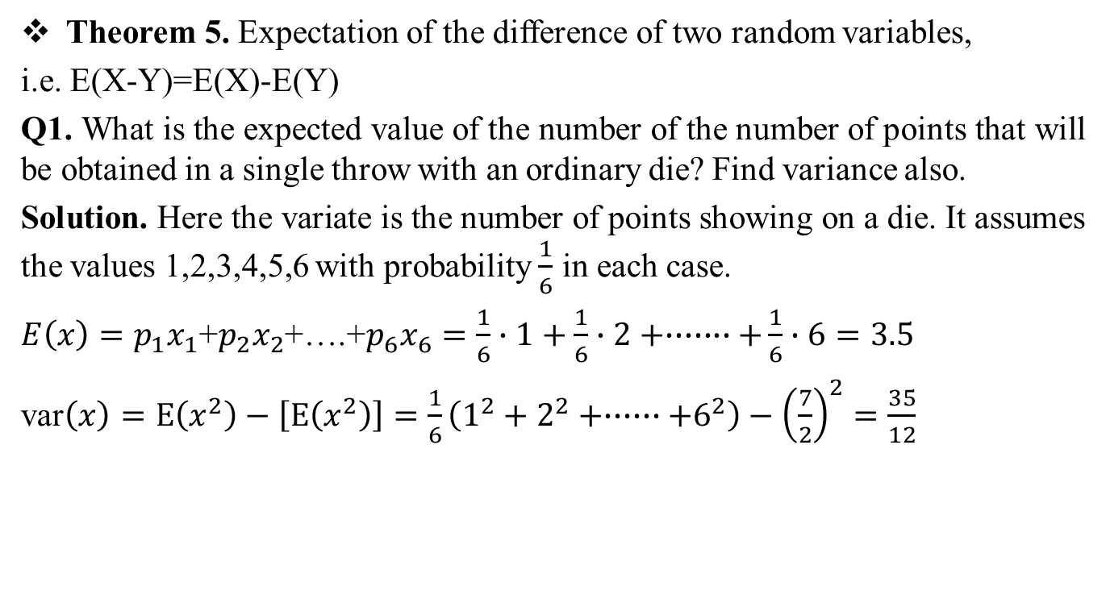

Mathematical expectation(CO4)
Theorem 5. Expectation of the difference of two random variables,
i.e. E(X-Y)=E(X)-E(Y)
Q1. What is the expected value of the number of the number of points that will be obtained in a single throw with an ordinary die? Find variance also.
Solution. Here the variate is the number of points showing on a die. It assumes the values 1,2,3,4,5,6 with probability $\frac{1}{6}$ in each case.
$E\left(x\right)=p_{1}x_{1}$+$p_{2}x_{2}$+….+$p_{6}x_{6}=\frac{1}{6}∙1+\frac{1}{6}∙2+∙∙∙∙∙∙∙+\frac{1}{6}∙6=3.5$
var$\left(x\right)=E\left(x^{2}\right)−\left[E\left(x^{2}\right)\right]=\frac{1}{6}\left(1^{2}+2^{2}+∙∙∙∙∙∙+6^{2}\right)−{\left(\frac{7}{2}\right)}^{2}=\frac{35}{12}$
$$∙$$

Slide 29
Daily Quiz(CO4)
Q1. What is the mathematical expectation of the sum of points on n dice?

Slide 30
Recap(CO4)
Mathematical expectation
Mean
Variance

Slide 31
Topic Objective(CO4)
In probability theory and statistics, the moment-generating function of a real-valued random variable is an alternative specification of its probability .

Slide 32
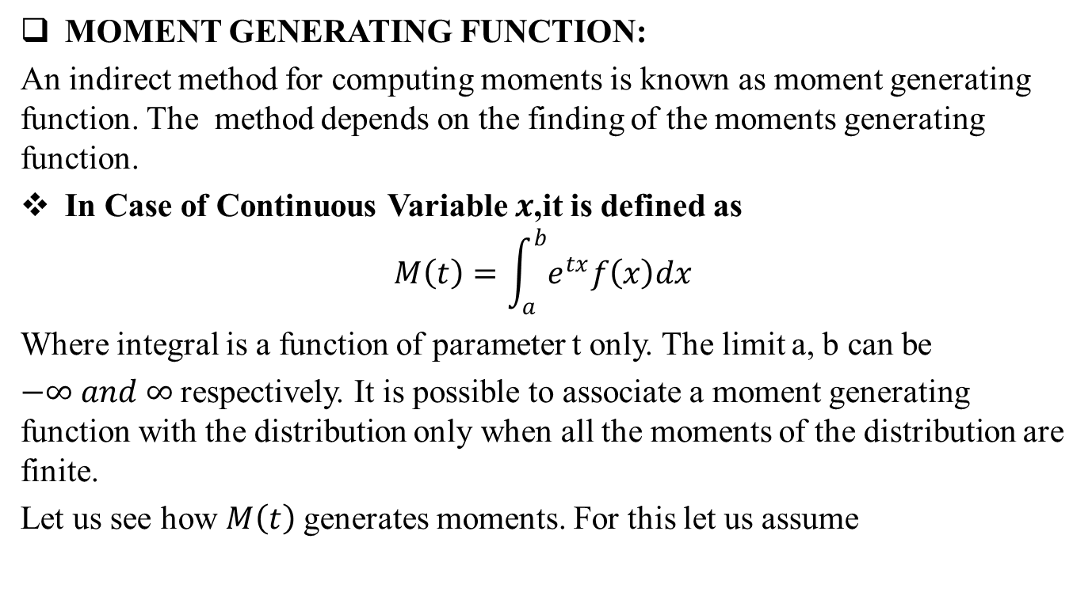
Moment Generating Function(CO4)
MOMENT GENERATING FUNCTION:
An indirect method for computing moments is known as moment generating function. The method depends on the finding of the moments generating function.
In Case of Continuous Variable $x$,it is defined as
$$M\left(t\right)=\int_{a}^{b}{e^{tx}f\left(x\right)dx}$$
Where integral is a function of parameter t only. The limit a, b can be
$−∞ and ∞$respectively. It is possible to associate a moment generating function with the distribution only when all the moments of the distribution are finite.
Let us see how $M\left(t\right)$generates moments. For this let us assume

Slide 33
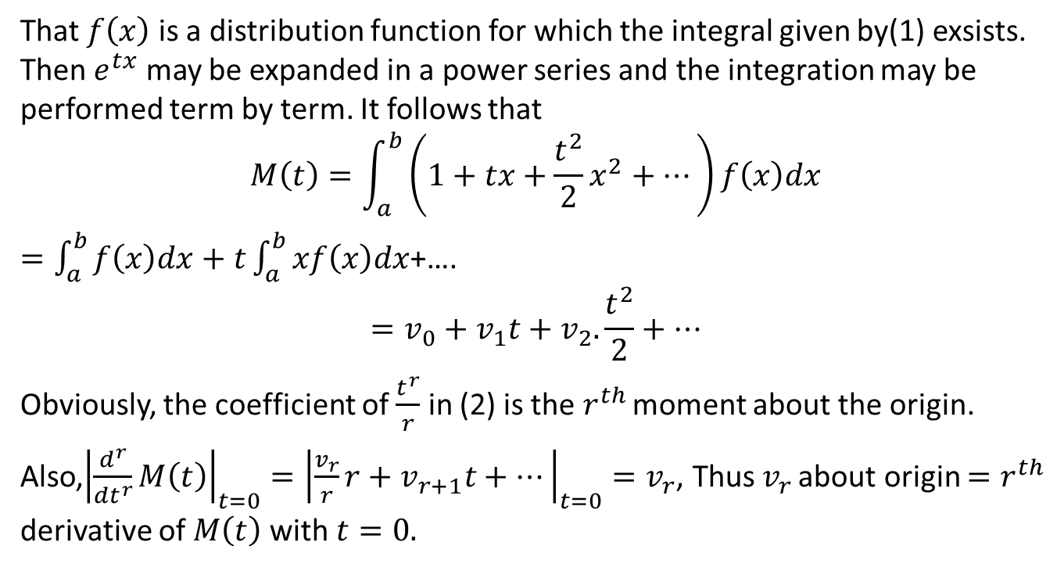
Moment Generating Function(CO4)
That $f\left(x\right)$ is a distribution function for which the integral given by(1) exsists. Then $e^{tx}$ may be expanded in a power series and the integration may be performed term by term. It follows that
$$M\left(t\right)=\int_{a}^{b}{\left(1+tx+\frac{t^{2}}{2}x^{2}+…\right)f\left(x\right)dx}$$
$=\int_{a}^{b}{f\left(x\right)dx+t\int_{a}^{b}{xf\left(x\right)dx}}$+….
$$=v_{0}+v_{1}t+v_{2}.\frac{t^{2}}{2}+…$$
Obviously, the coefficient of $\frac{t^{r}}{r}$ in (2) is the $r^{th }$moment about the origin.
Also,${\left|\frac{d^{r}}{{dt}^{r}}M\left(t\right)\right|}_{t=0}={\left|\frac{v_{r}}{r}r+v_{r+1}t+…\right|}_{t=0}=v_{r}$, Thus $v_{r }$about origin $=r^{th}$ derivative of $M\left(t\right)$with $t=0.$

Slide 34
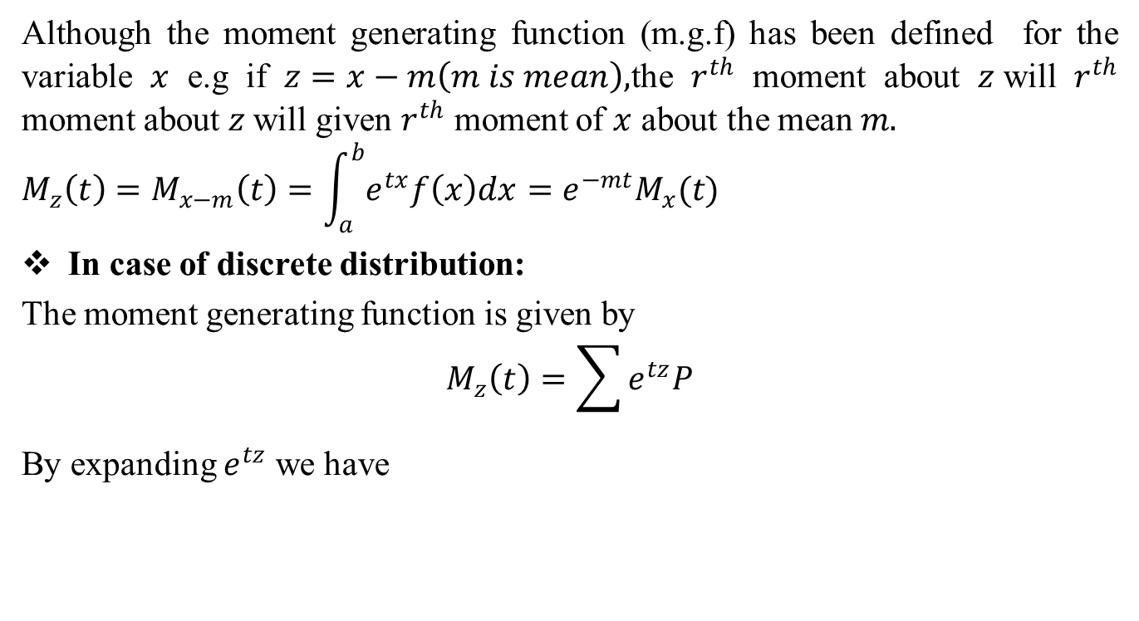
Moment Generating Function(CO4)
Although the moment generating function (m.g.f) has been defined for the variable $x$ e.g if $z=x−m\left(m is mean\right),$the $r^{th}$ moment about $z$will $r^{th}$ moment about $z$will given $r^{th}$ moment of $x$ about the mean $m.$
$$M_{z}\left(t\right)=M_{x−m}\left(t\right)=\int_{a}^{b}{e^{tx}f\left(x\right)dx=e^{−mt}M_{x}(t)}$$
In case of discrete distribution:
The moment generating function is given by
$$M_{z}\left(t\right)=\sum{e^{tz}P}$$
By expanding $e^{tz}$ we have

Slide 35
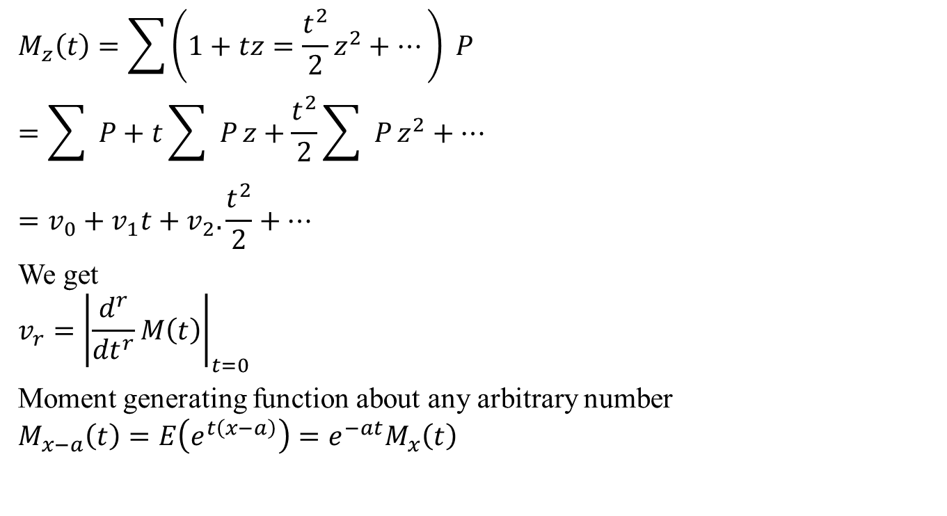
Moment Generating Function(CO4)
$$M_{z}\left(t\right)=\sum{\left(1+tz=\frac{t^{2}}{2}z^{2}+…\right) P}$$
$$=\sum{ P}+t\sum{ P}z+\frac{t^{2}}{2}\sum{ P}z^{2}+…$$
$$=v_{0}+v_{1}t+v_{2}.\frac{t^{2}}{2}+…$$
We get
$$v_{r}={\left|\frac{d^{r}}{{dt}^{r}}M\left(t\right)\right|}_{t=0}$$
Moment generating function about any arbitrary number
$$M_{x−a}\left(t\right)=E\left(e^{t\left(x−a\right)}\right)=e^{−at}M_{x}\left(t\right)$$

Slide 36
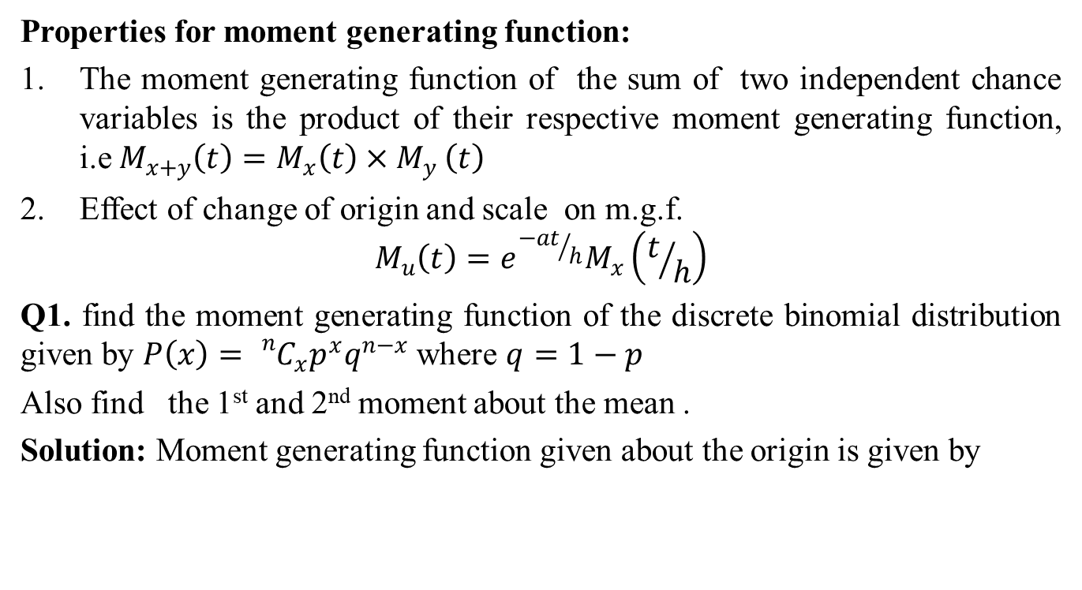
Moment Generating Function(CO4)
Properties for moment generating function:
The moment generating function of the sum of two independent chance variables is the product of their respective moment generating function, i.e${ M}_{x+y}\left(t\right)=M_{x}\left(t\right){×M}_{y}\left(t\right)$
Effect of change of origin and scale on m.g.f.
$$M_{u}\left(t\right)=e^{{−at}/h}M_{x}\left(t/h\right)$$
Q1. find the moment generating function of the discrete binomial distribution given by $P\left(x\right)={}_{}^{n}{C_{x}p^{x}q^{n−x}}$ where $q=1−p$
Also find the 1st and 2nd moment about the mean .
Solution: Moment generating function given about the origin is given by

Slide 37
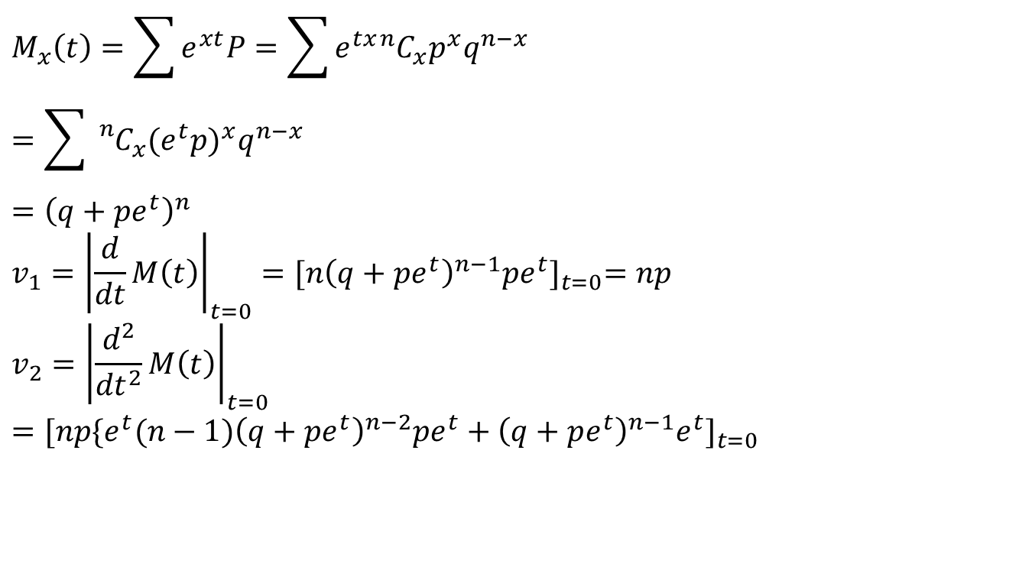
Moment Generating Function(CO4)
$$M_{x}\left(t\right)=\sum{e^{xt}P=\sum{e^{tx}{}_{ }^{n}{C_{x}p^{x}q^{n−x}}} }$$
$$=\sum{{}_{}^{n}{C_{x}{(e^{t}p)}^{x}q^{n−x}}}$$
$$={\left(q+pe^{t}\right)}^{n}$$
$$v_{1}={\left|\frac{d}{dt}M\left(t\right)\right|}_{t=0}={[n{\left(q+pe^{t}\right)}^{n−1}pe^{t}]}_{t=0}=np$$
$$v_{2}={\left|\frac{d^{2}}{{dt}^{2}}M\left(t\right)\right|}_{t=0}={[np{\{e^{t}(n−1)\left(q+pe^{t}\right)}^{n−2}pe^{t}+{\left(q+pe^{t}\right)}^{n−1}e^{t}]}_{t=0}$$

Slide 38
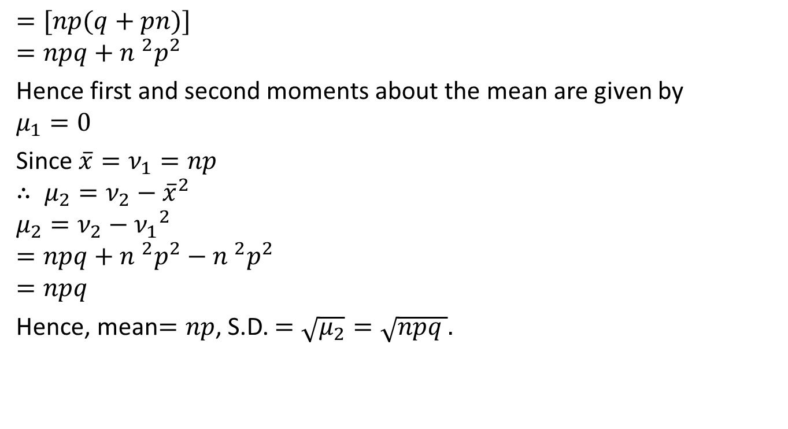
Moment Generating Function(CO4)
$$=[np(q+pn)]$$
$$=npq+{n }^{2}p^{2}$$
Hence first and second moments about the mean are given by
$$μ_{1}=0$$
Since $\overline{x}=ν_{1}=np$
$$∴ μ_{2}=ν_{2}−{\overline{x}}^{2}$$
$$μ_{2}=ν_{2}−{ν_{1}}^{2}$$
$$=npq+{n }^{2}p^{2}−{n }^{2}p^{2}$$
$$=npq$$
Hence, mean$=np$, S.D. $=\sqrt{μ_{2}}=\sqrt{npq }.$

Slide 39
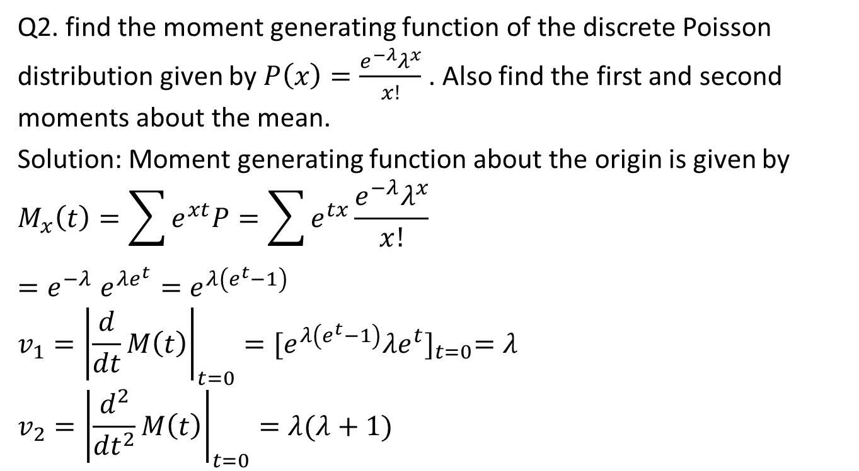
Moment Generating Function(CO4)
Q2. find the moment generating function of the discrete Poisson distribution given by $P\left(x\right)=\frac{e^{−λ}λ^{x}}{x!}$ . Also find the first and second moments about the mean.
Solution: Moment generating function about the origin is given by
$$M_{x}\left(t\right)=\sum{e^{xt}P=\sum{e^{tx}}\frac{e^{−λ}λ^{x}}{x!}}$$
$${=e}^{−λ}e^{λe^{t}}=e^{λ\left(e^{t}−1\right)}$$
$$v_{1}={\left|\frac{d}{dt}M\left(t\right)\right|}_{t=0}={[e^{λ\left(e^{t}−1\right)}λe^{t}]}_{t=0}=λ$$
$$v_{2}={\left|\frac{d^{2}}{{dt}^{2}}M\left(t\right)\right|}_{t=0}=λ(λ+1)$$

Slide 40
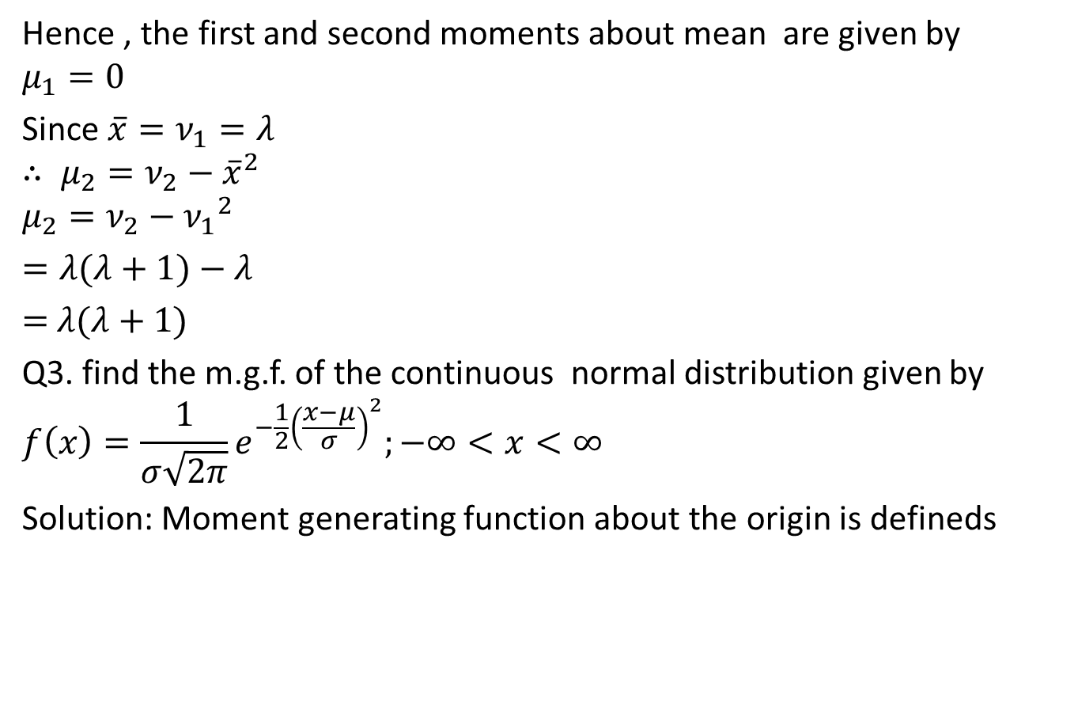
Moment Generating Function(CO4)
Hence , the first and second moments about mean are given by
$$μ_{1}=0$$
Since $\overline{x}=ν_{1}=λ$
$$∴ μ_{2}=ν_{2}−{\overline{x}}^{2}$$
$$μ_{2}=ν_{2}−{ν_{1}}^{2}$$
$=λ(λ+1)−$ $λ$
$=$ $λ(λ+1)$
Q3. find the m.g.f. of the continuous normal distribution given by
$$f\left(x\right)=\frac{1}{σ\sqrt{2π}}e^{−\frac{1}{2}{\left(\frac{x−μ}{σ}\right)}^{2}};−∞<x<∞$$
Solution: Moment generating function about the origin is defineds

Slide 41

Moment Generating Function(CO4)
$$M_{x}\left(t\right)=E\left(e^{tx}\right)=\int_{−∞}^{∞}{e^{tx}f\left(x\right)dx}$$
$$=\int_{−∞}^{∞}{e^{tx}\frac{1}{σ\sqrt{2π}}e^{−\frac{1}{2}{\left(\frac{x−μ}{σ}\right)}^{2}}dx}$$
$=\frac{1}{\sqrt{2π}}\int_{−∞}^{∞}{e^{−tσz}e^{−\frac{1}{2}z^{2}}dz}$; where $z=\frac{x−μ}{σ}$
$$=\frac{1}{\sqrt{2π}}e^{\left(μt+\frac{1}{2}t^{2}σ^{2}\right)}\int_{−∞}^{∞}{e^{−\frac{1}{2}({z−tσ)}^{2}}dz}$$
$$=e^{\left(μt+\frac{1}{2}t^{2}σ^{2}\right)}.1$$
$${=e}^{\left(μt+\frac{1}{2}t^{2}σ^{2}\right)}$$

Slide 42

Daily Quiz(CO4)
Q1. Find the moment generating function about origin of a random variable $X$ whose probability density function is given by
$f\left(x\right)= \frac{1}{2}e^{−\left|x\right|}.$

Slide 43

Weekly Assignments (CO4)
Find the moment generating function about origin of random variable $X$ whose p.m.f is given by $p\left(x\right)=pq^{x−1}, x=1,2,3……$ Hence find mean and variance of the distribution.
Find the mean and variance of Binomial distribution.
Find the mean and variance of normal distribution.

Slide 44
Recap(CO4)
Mathematical expectation
Mean
Variance
Moment Generating Function

Slide 45
Unit Objective(CO4)
A basic knowledge in probability theory.
The student is able to reflect developed mathematical methods in probability and statistics.
Understand the concept of Probability and its usage in various business applications.
The binomial distribution model allows us to compute the probability of observing a specified number of "successes" when the process is repeated a specific number of times
Poisson Distribution is a tool that helps to predict the probability of certain events from happening when you know how often the event has occurred.
To learn the characteristics of a typical normal curve.
7. To explore the key properties, such as the moment-generating function, mean and variance, of a normal random variable.

Slide 46
Topic Objective(CO4)
The probability distributions are very much helpful for making predictions. Estimates and predictions form an important part of research investigation. With the help of Probability distributions, we make estimates and predictions for the further analysis.

Slide 47
Probability distributions(CO4)
Theoretical probability distribution
Discrete probability distributions
Continuous probability distributions
Binomial Distribution
Poisson Distribution
Normal Distribution
t- Distribution
F-Distribution

Slide 48

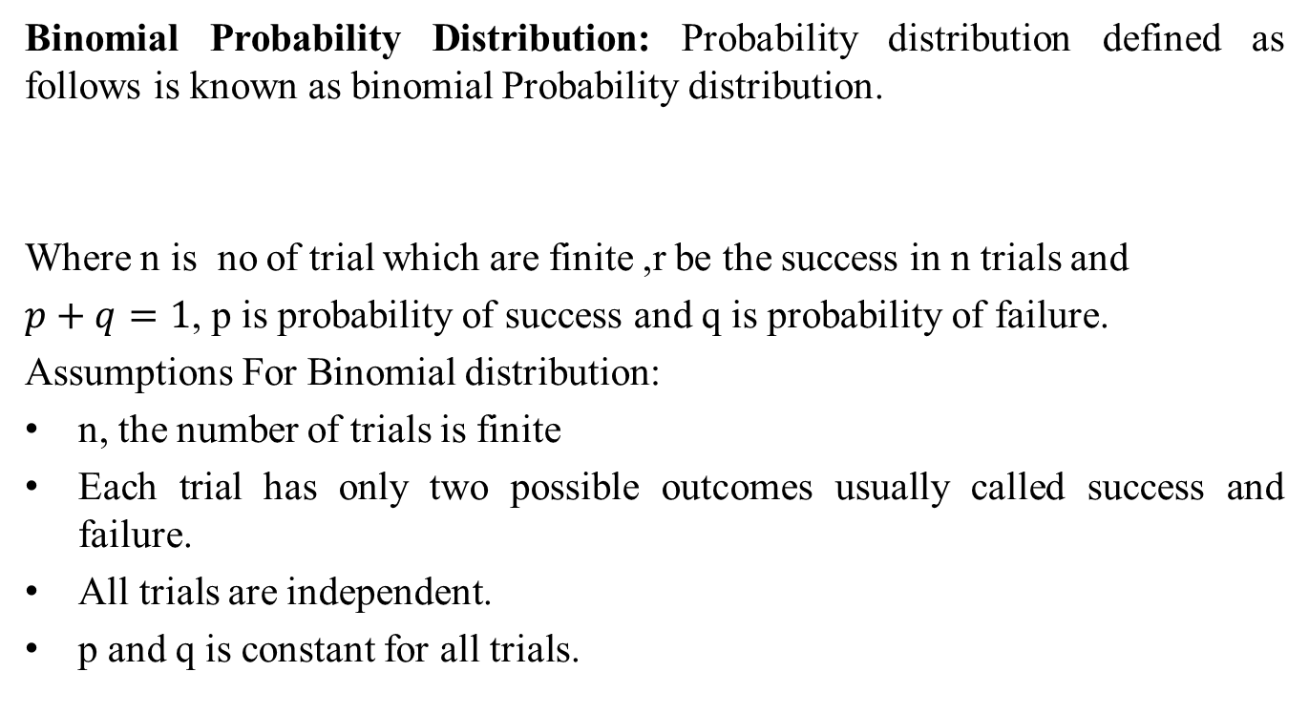
Binomial Distribution(CO4)
Binomial Probability Distribution: Probability distribution defined as follows is known as binomial Probability distribution.
Where n is no of trial which are finite ,r be the success in n trials and
$p+q=1$, p is probability of success and q is probability of failure.
Assumptions For Binomial distribution:
n, the number of trials is finite
Each trial has only two possible outcomes usually called success and failure.
All trials are independent.
p and q is constant for all trials.
$P\left(X=r\right)={{}_{ }^{n}C}_{r}p^{r}q^{n−r}$,$r=1,2…n$

Slide 49
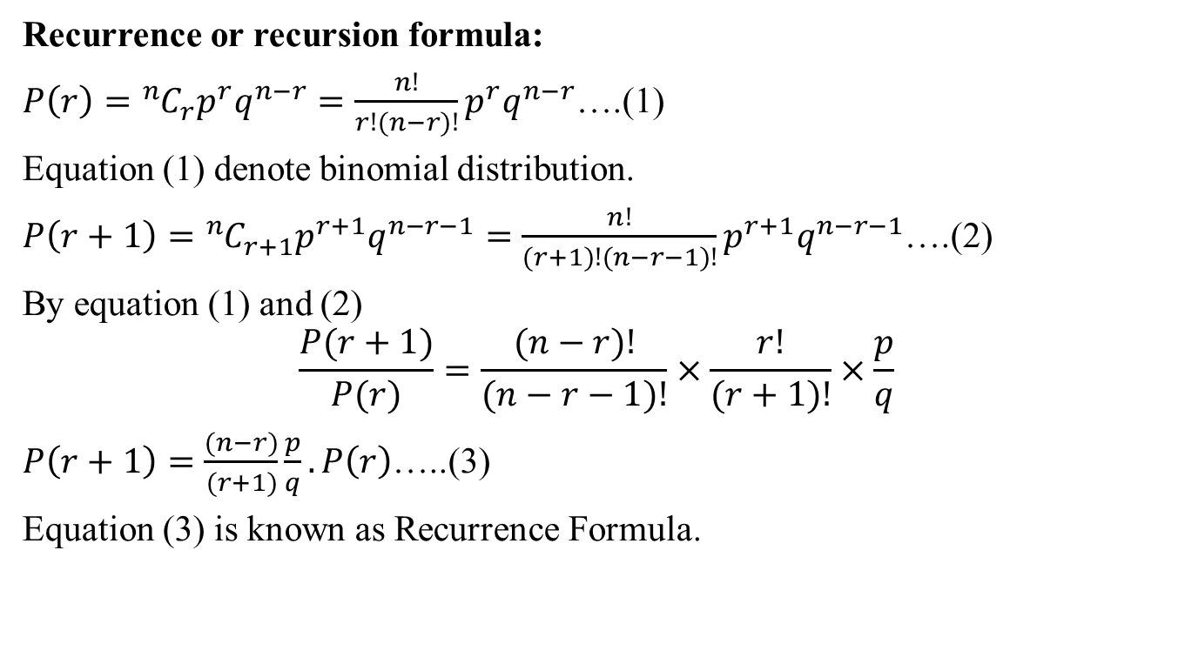
Cont…(CO4)
Recurrence or recursion formula:
$P\left(r\right)={{}_{ }^{n}C}_{r}p^{r}q^{n−r}=\frac{n!}{r!(n−r)!}p^{r}q^{n−r}$….(1)
Equation (1) denote binomial distribution.
$P\left(r+1\right)={{}_{ }^{n}C}_{r+1}p^{r+1}q^{n−r−1}=\frac{n!}{(r+1)!(n−r−1)!}p^{r+1}q^{n−r−1}$….(2)
By equation (1) and (2)
$$\frac{P(r+1)}{P(r)}=\frac{(n−r)!}{(n−r−1)!}×\frac{r!}{(r+1)!}×\frac{p}{q}$$
$P\left(r+1\right)=\frac{(n−r)}{(r+1)}\frac{p}{q}. P\left(r\right)$…..(3)
Equation (3) is known as Recurrence Formula.

Slide 50
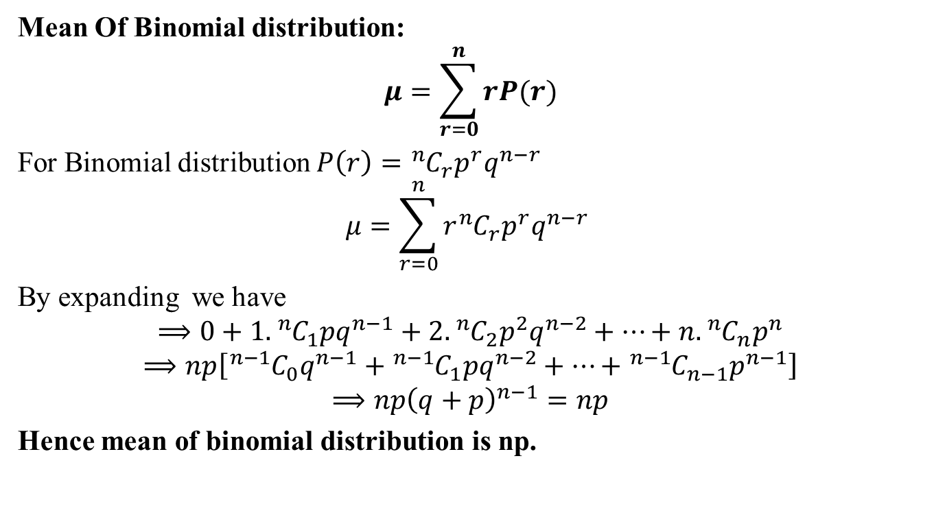
Cont…(CO4)
Mean Of Binomial distribution:
$$μ=\sum_{r=0}^{n}{rP(r)}$$
For Binomial distribution $P\left(r\right)={{}_{ }^{n}C}_{r}p^{r}q^{n−r}$
$$μ=\sum_{r=0}^{n}{r{{}_{ }^{n}C}_{r}p^{r}q^{n−r} }$$
By expanding we have
$$⟹0+1.{{}_{ }^{n}C}_{1}pq^{n−1}+2.{{}_{ }^{n}C}_{2}p^{2}q^{n−2}+…+n.{{}_{ }^{n}C}_{n}p^{n}$$
$$⟹np\left[{{}_{ }^{n−1}C}_{0}q^{n−1}+{{}_{ }^{n−1}C}_{1}pq^{n−2}+…+{{}_{ }^{n−1}C}_{n−1}p^{n−1}\right]$$
$$⟹np{\left(q+p\right)}^{n−1}=np$$
Hence mean of binomial distribution is np.

Slide 51
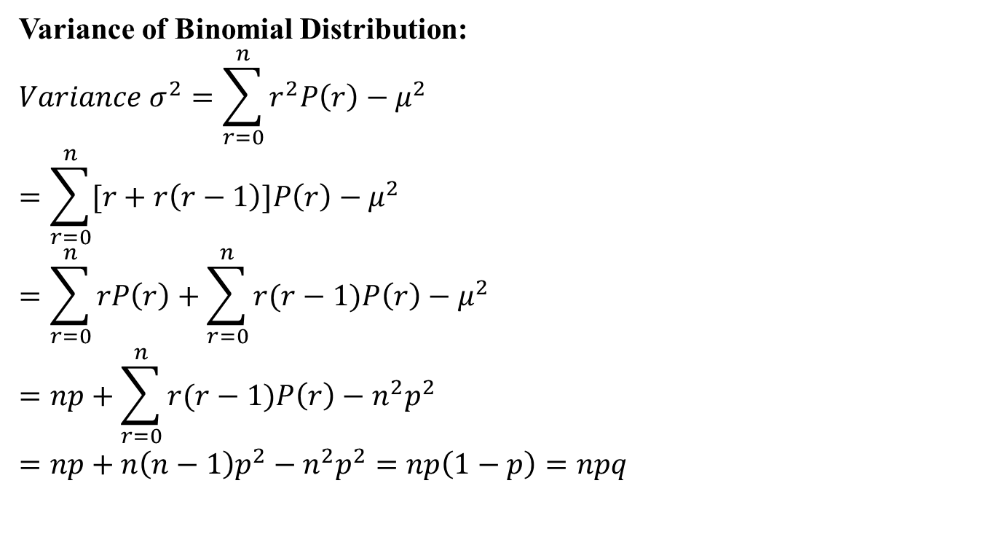
Cont…(CO4)
Variance of Binomial Distribution:
$$Variance σ^{2}=\sum_{r=0}^{n}{r^{2}P\left(r\right)−μ^{2}}$$
$$=\sum_{r=0}^{n}{[r+r\left(r−1\right)]P\left(r\right)−μ^{2}}$$
$$=\sum_{r=0}^{n}{rP\left(r\right)+\sum_{r=0}^{n}{r(r−1)P\left(r\right)−μ^{2}}}$$
$$=np+\sum_{r=0}^{n}{r(r−1)P\left(r\right)−n^{2}p^{2}}$$
$$=np+n\left(n−1\right)p^{2}−n^{2}p^{2}=np\left(1−p\right)=npq$$

Slide 52
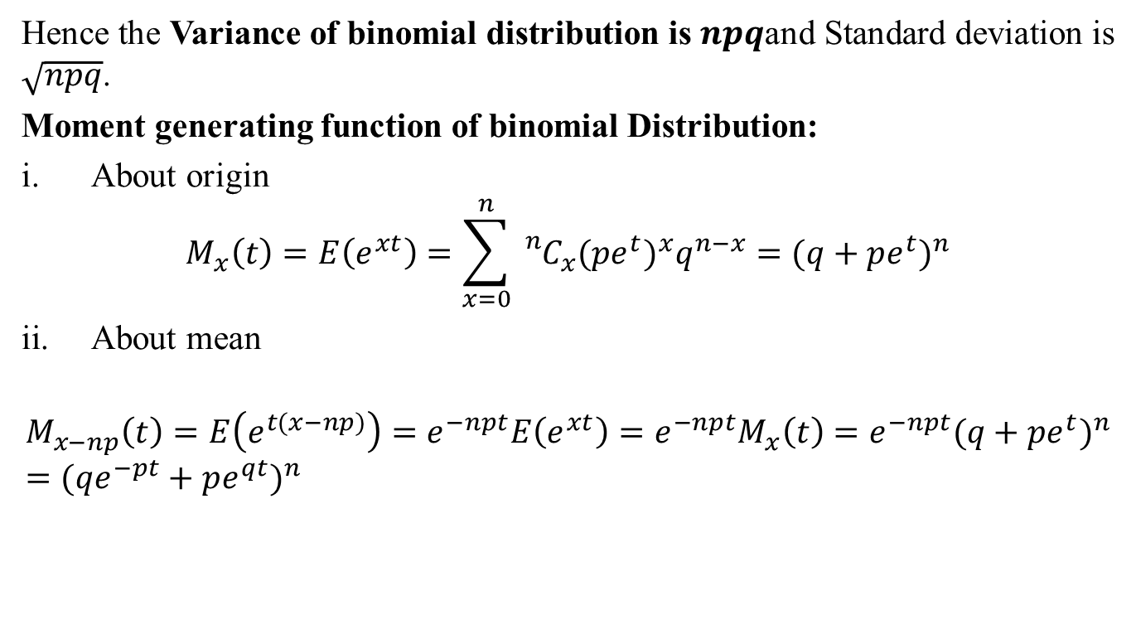
Cont…(CO4)
Hence the Variance of binomial distribution is $npq$and Standard deviation is $\sqrt{npq}$.
Moment generating function of binomial Distribution:
About origin
$$M_{x}\left(t\right)=E\left(e^{xt}\right)=\sum_{x=0}^{n}{{{}_{}^{n}C}_{x}({pe^{t})}^{x}q^{n−x}}={(q+pe^{t})}^{n}$$
About mean
$$M_{x−np}\left(t\right)=E\left(e^{t(x−np)}\right)=e^{−npt}E\left(e^{xt}\right)=e^{−npt}M_{x}\left(t\right)={e^{−npt}(q+pe^{t})}^{n}={(qe^{−pt}+pe^{qt})}^{n}$$

Slide 53
Cont…(CO4)
Applications of Binomial Distribution:
In problem concerning no. of defectives in sample production line.
In estimation of reliability of systems.
No. of rounds fired from a gun hitting a target.
In radar detection.
Q1. If 10% of bolts are produced by a machine are defective , determine the probability that out of 10 bolts chosen at random
1
None
At most 2 bolts will be defective

Slide 54
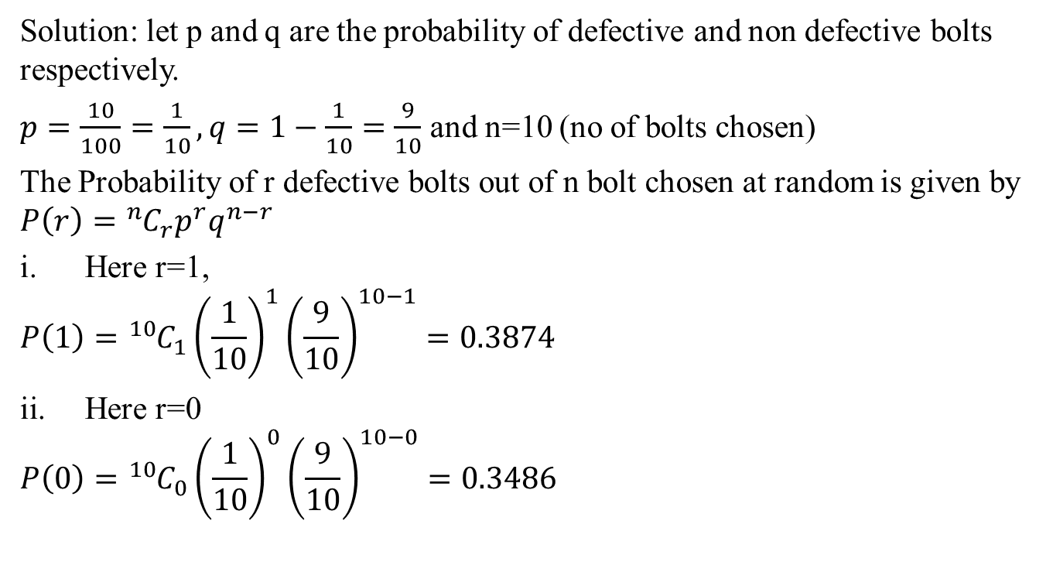
Problem’s based on Binomial
Distribution(CO4)
Solution: let p and q are the probability of defective and non defective bolts respectively.
$p=\frac{10}{100}=\frac{1}{10},q=1−\frac{1}{10}=\frac{9}{10}$ and n=10 (no of bolts chosen)
The Probability of r defective bolts out of n bolt chosen at random is given by $P\left(r\right)={{}_{ }^{n}C}_{r}p^{r}q^{n−r}$
Here r=1,
$$P\left(1\right)={{}_{ }^{10}C}_{1}{\left(\frac{1}{10}\right)}^{1}{\left(\frac{9}{10}\right)}^{10−1}=0.3874$$
Here r=0
$$P\left(0\right)={{}_{ }^{10}C}_{0}{\left(\frac{1}{10}\right)}^{0}{\left(\frac{9}{10}\right)}^{10−0}=0.3486$$

Slide 55
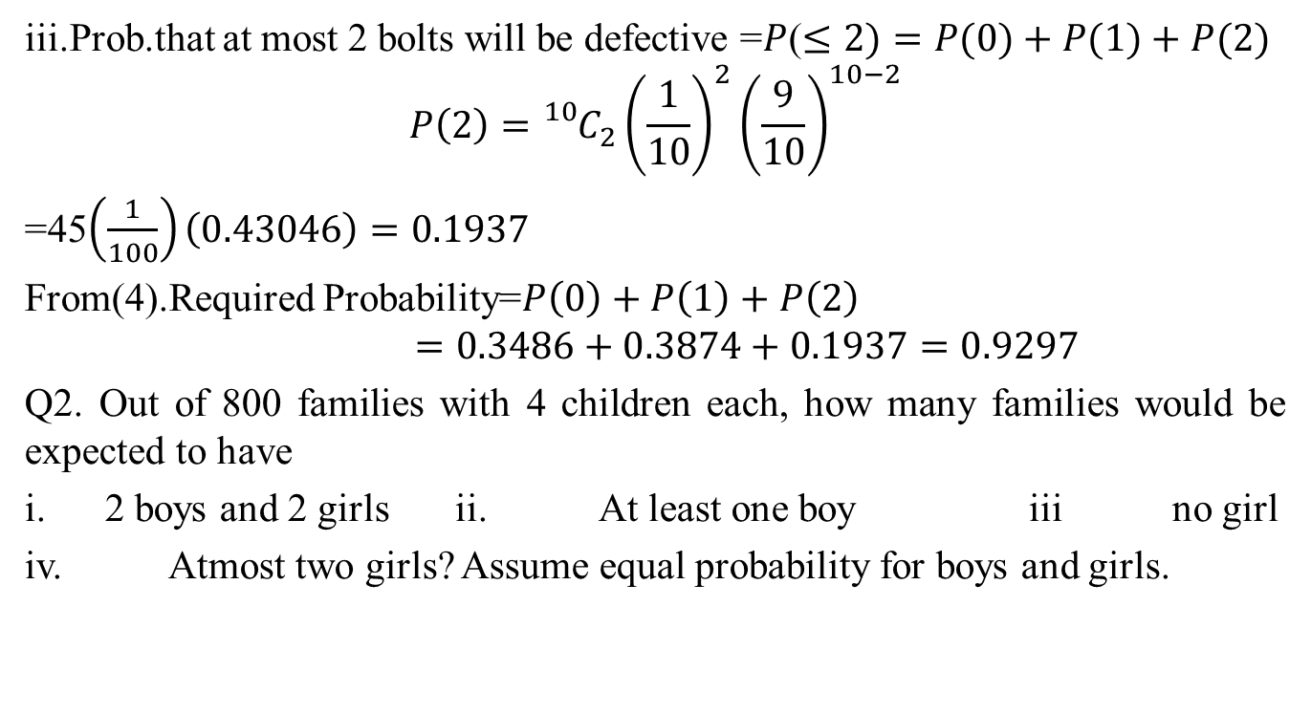
Problem’s based on Binomial
distribution(CO4)
iii.Prob.that at most 2 bolts will be defective =$P$($≤2)=P(0)+P(1)+P(2)$
$$P\left(2\right)={{}_{}^{10}C}_{2}{\left(\frac{1}{10}\right)}^{2}{\left(\frac{9}{10}\right)}^{10−2}$$
=45$\left(\frac{1}{100}\right)\left(0.43046\right)=0.1937$
From(4).Required Probability=$P\left(0\right)+P\left(1\right)+P\left(2\right)$
$$=0.3486+0.3874+0.1937=0.9297$$
Q2. Out of 800 families with 4 children each, how many families would be expected to have
2 boys and 2 girls ii. At least one boy iii no girl
iv. Atmost two girls? Assume equal probability for boys and girls.

Slide 56
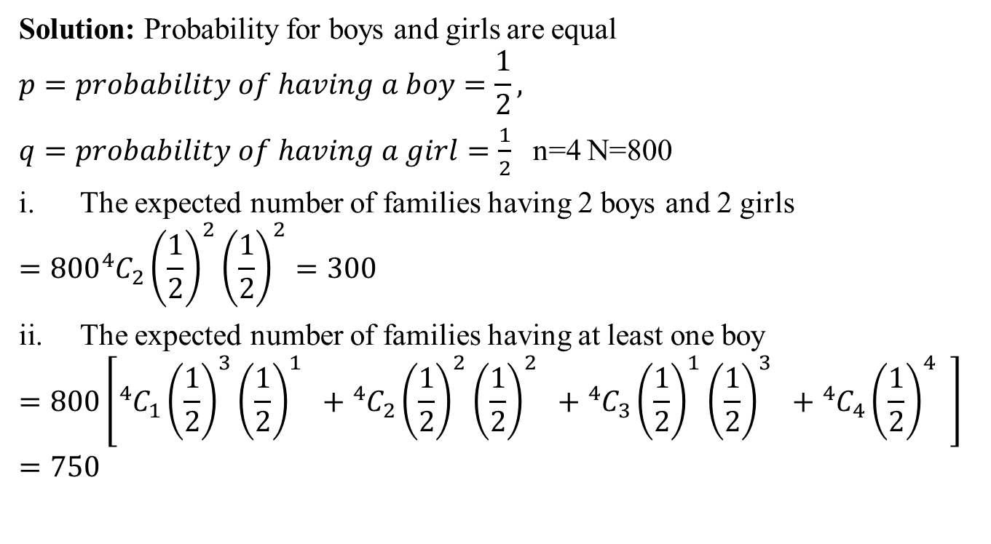
Cont…(CO4)
Solution: Probability for boys and girls are equal
$$p=probability of having a boy=\frac{1}{2},$$
$q=probability of having a girl=\frac{1}{2}$ n=4 N=800
The expected number of families having 2 boys and 2 girls
$$=800{}_{ }^{4}{C_{2}{\left(\frac{1}{2}\right)}^{2}{\left(\frac{1}{2}\right)}^{2}=300}$$
The expected number of families having at least one boy
$$=800\left[{}_{ }^{4}{C_{1}{\left(\frac{1}{2}\right)}^{3}{\left(\frac{1}{2}\right)}^{1}} +{}_{ }^{4}{C_{2}{\left(\frac{1}{2}\right)}^{2}{\left(\frac{1}{2}\right)}^{2}} +{}_{ }^{4}{C_{3}{\left(\frac{1}{2}\right)}^{1}{\left(\frac{1}{2}\right)}^{3}} +{}_{ }^{4}{C_{4}{\left(\frac{1}{2}\right)}^{4}} \right]=750$$

Slide 57
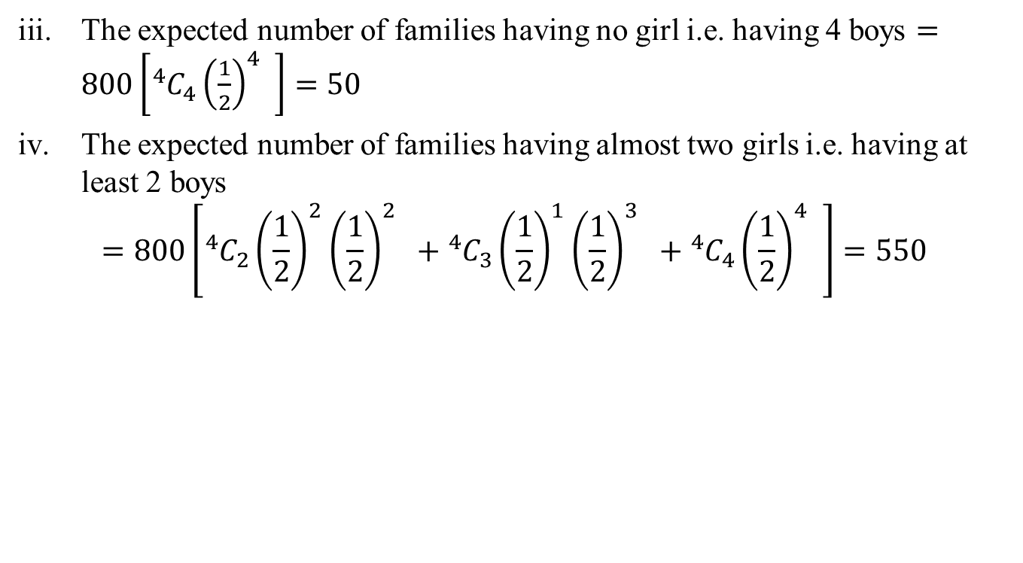
Cont…(CO4)
The expected number of families having no girl i.e. having 4 boys $=800\left[{}_{ }^{4}{C_{4}{\left(\frac{1}{2}\right)}^{4}} \right]=50$
The expected number of families having almost two girls i.e. having at least 2 boys
$$=800\left[{}_{ }^{4}{C_{2}{\left(\frac{1}{2}\right)}^{2}{\left(\frac{1}{2}\right)}^{2}} +{}_{ }^{4}{C_{3}{\left(\frac{1}{2}\right)}^{1}{\left(\frac{1}{2}\right)}^{3}} +{}_{ }^{4}{C_{4}{\left(\frac{1}{2}\right)}^{4}} \right]=550$$

Slide 58
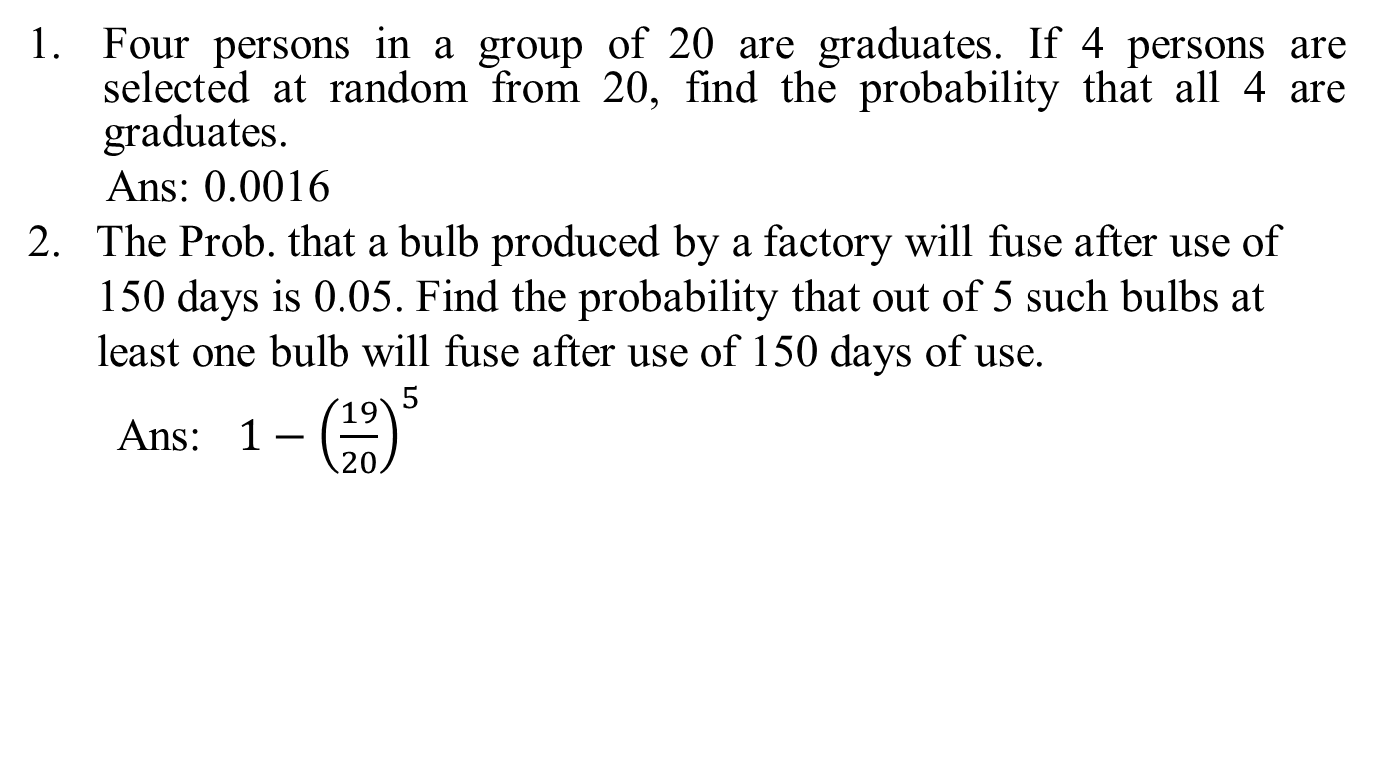
Daily Quiz(CO4)
Four persons in a group of 20 are graduates. If 4 persons are selected at random from 20, find the probability that all 4 are graduates.
Ans: 0.0016
2. The Prob. that a bulb produced by a factory will fuse after use of
150 days is 0.05. Find the probability that out of 5 such bulbs at
least one bulb will fuse after use of 150 days of use.
Ans: $1−{\left(\frac{19}{20}\right)}^{5}$

Slide 59
Recap (CO4)
Mathematical expectation
Mean
Variance
Moment Generating Function
Binomial distribution

Slide 60
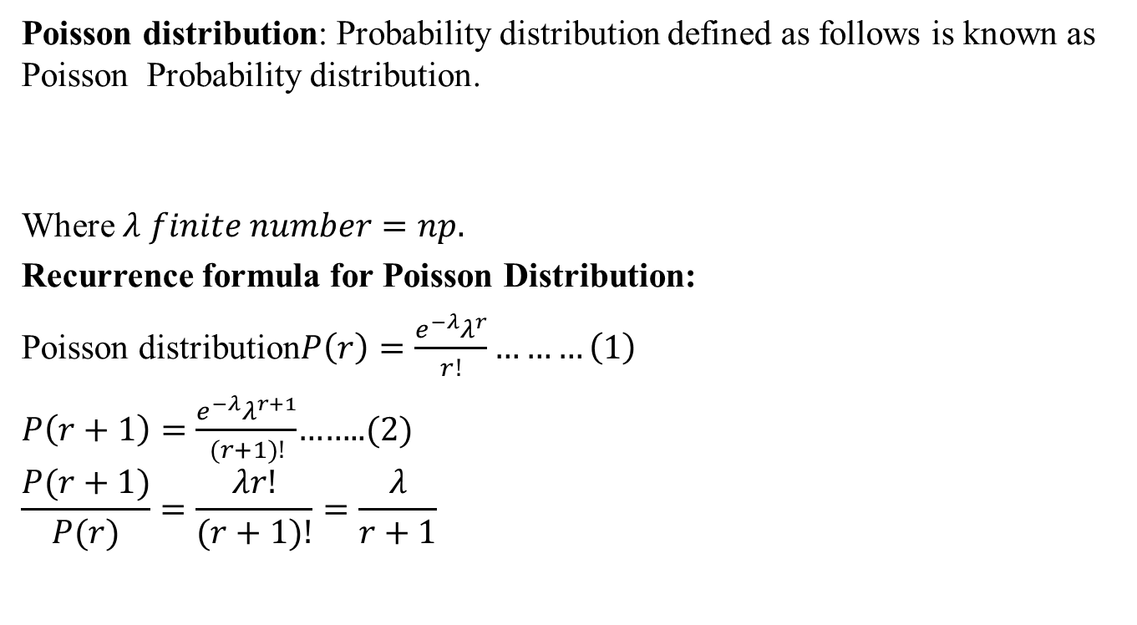

Poisson Distribution(CO4)
Poisson distribution: Probability distribution defined as follows is known as Poisson Probability distribution.
Where $λ finite number=np.$
Recurrence formula for Poisson Distribution:
Poisson distribution$P\left(r\right)=\frac{e^{−λ}λ^{r}}{r!}………\left(1\right)$
$P\left(r+1\right)=\frac{e^{−λ}λ^{r+1}}{(r+1)!}$……..(2)
$$\frac{P(r+1)}{P(r)}=\frac{λr!}{(r+1)!}=\frac{λ}{r+1}$$
$$P\left(X=r\right)=\frac{e^{−λ}λ^{r}}{r!}, \left(r=0,1,2,3….\right)$$

Slide 61
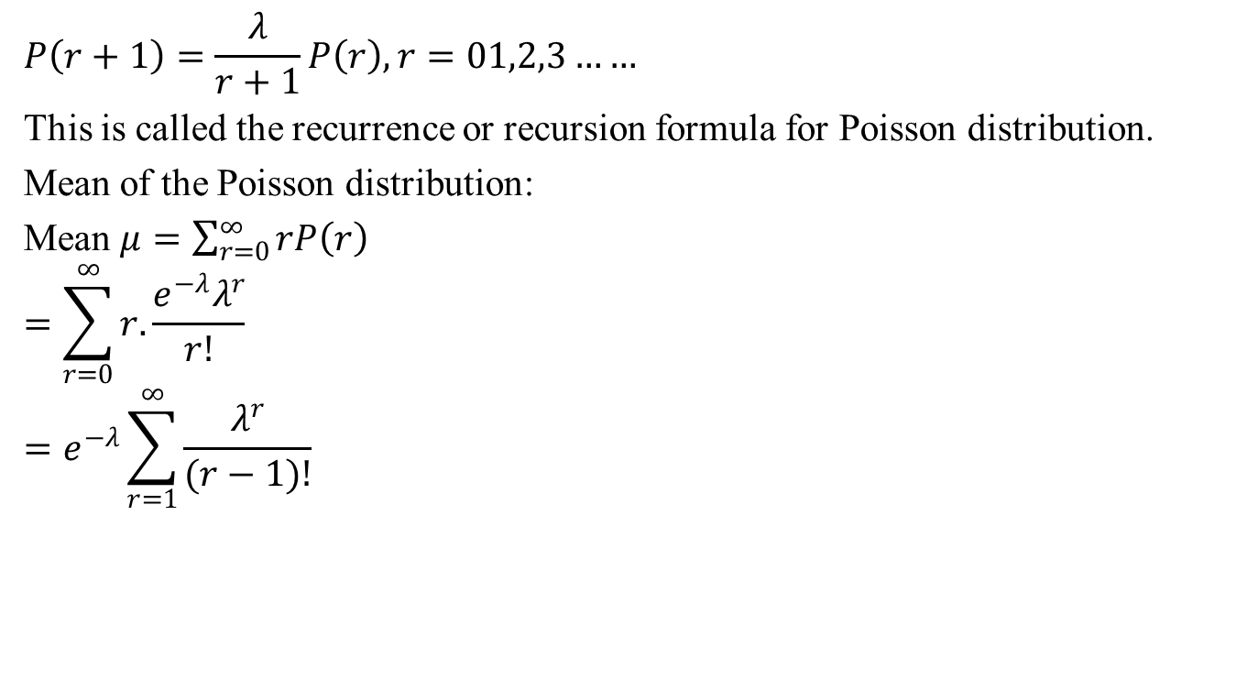
Cont…(CO4)
$$P\left(r+1\right)=\frac{λ}{r+1}P\left(r\right), r=01,2,3……$$
This is called the recurrence or recursion formula for Poisson distribution.
Mean of the Poisson distribution:
Mean $μ=\sum_{r=0}^{∞}{rP\left(r\right)}$
$$=\sum_{r=0}^{∞}{r.\frac{e^{−λ}λ^{r}}{r!}}$$
$$=e^{−λ}\sum_{r=1}^{∞}{\frac{λ^{r}}{(r−1)!}}$$

Slide 62

Cont…(CO4)
$$=e^{−λ}\left(λ+\frac{λ^{2}}{1!}+\frac{λ^{3}}{2!}+….\right)$$
$$={λe}^{−λ}\left(1+\frac{λ}{1!}+\frac{λ^{2}}{2!}+….\right)$$
$$={λe}^{−λ}\left(1+\frac{λ}{1!}+\frac{λ^{2}}{2!}+….\right)$$
$$={λe}^{−λ}e^{λ}=λ$$
Mean $=λ$ for Poisson distribution.
Variance of Poisson Distribution:
$$Variance σ^{2}=\sum_{r=0}^{∞}{r^{2}P\left(r\right)−μ^{2}}$$

Slide 63
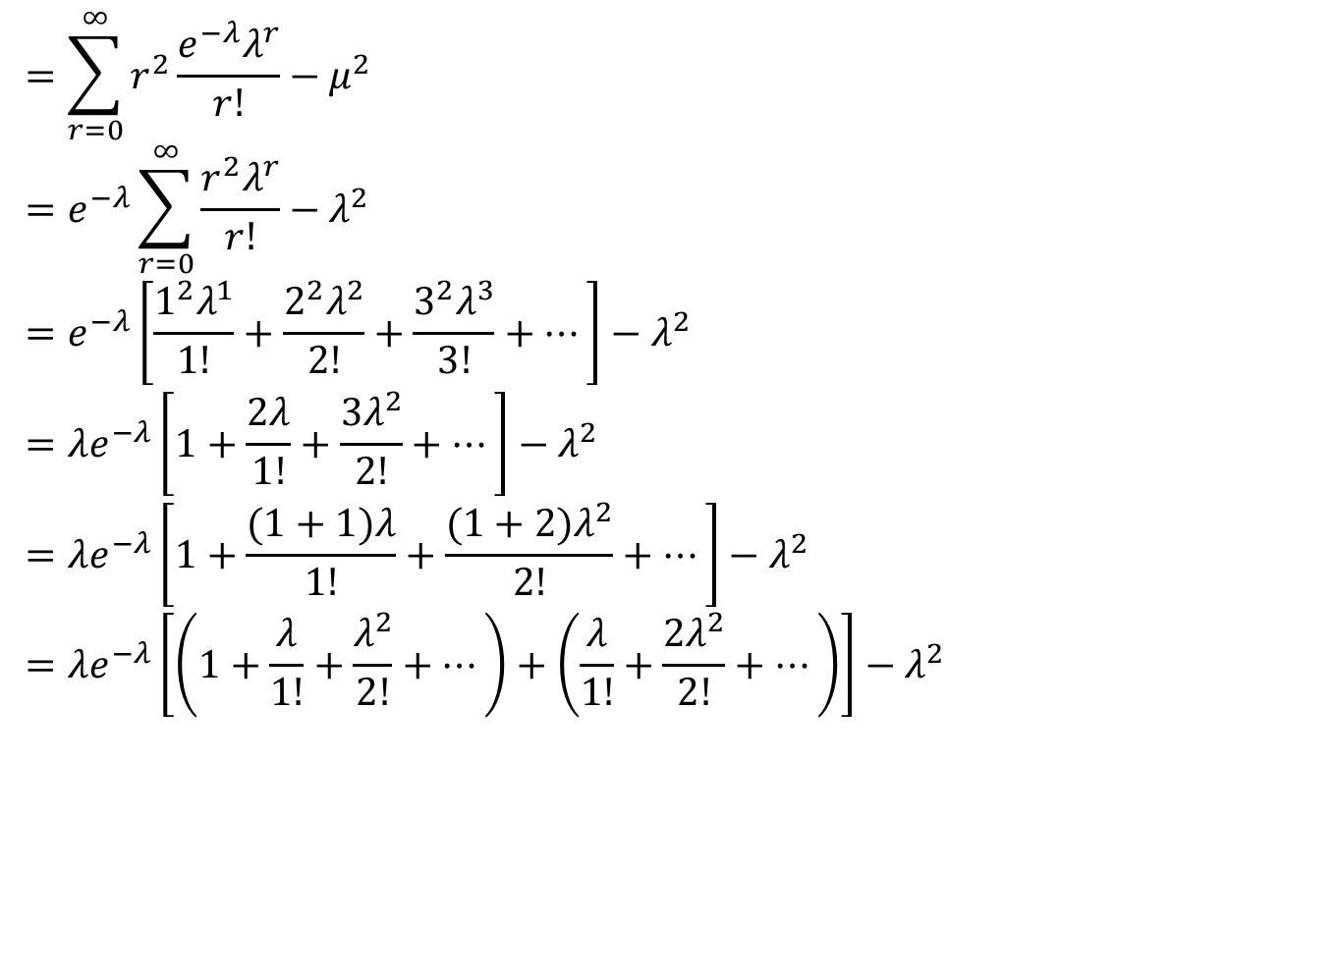
Cont…(CO4)
$$=\sum_{r=0}^{∞}{r^{2}\frac{e^{−λ}λ^{r}}{r!}−μ^{2}}$$
$$=e^{−λ}\sum_{r=0}^{∞}{\frac{r^{2}λ^{r}}{r!}−λ^{2}}$$
$$=e^{−λ}\left[\frac{1^{2}λ^{1}}{1!}+\frac{2^{2}λ^{2}}{2!}+\frac{3^{2}λ^{3}}{3!}+…\right]−λ^{2}$$
$$={λe}^{−λ}\left[1+\frac{2λ}{1!}+\frac{3λ^{2}}{2!}+…\right]−λ^{2}$$
$$={λe}^{−λ}\left[1+\frac{(1+1)λ}{1!}+\frac{(1+2)λ^{2}}{2!}+…\right]−λ^{2}$$
$$={λe}^{−λ}\left[\left(1+\frac{λ}{1!}+\frac{λ^{2}}{2!}+…\right)+\left(\frac{λ}{1!}+\frac{{2λ}^{2}}{2!}+…\right)\right]−λ^{2}$$

Slide 64
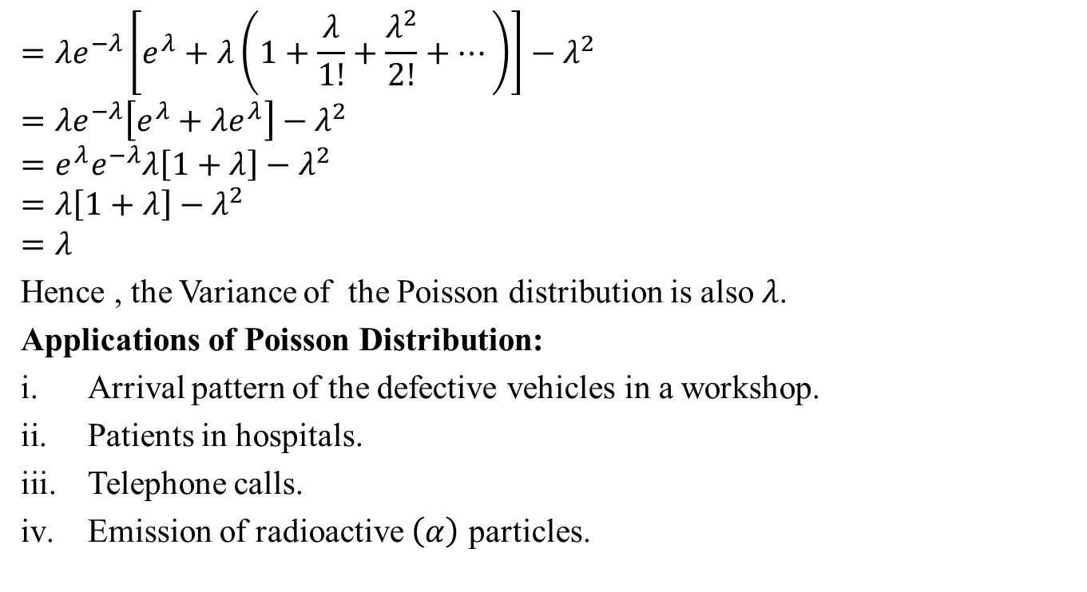
Cont…(CO4)
$$={λe}^{−λ}\left[e^{λ}+λ\left(1+\frac{λ}{1!}+\frac{λ^{2}}{2!}+…\right)\right]−λ^{2}$$
$$={λe}^{−λ}\left[e^{λ}+λe^{λ}\right]−λ^{2}$$
$$=e^{λ}e^{−λ}λ\left[1+λ\right]−λ^{2}$$
$$=λ\left[1+λ\right]−λ^{2}$$
$$=λ$$
Hence , the Variance of the Poisson distribution is also $λ$.
Applications of Poisson Distribution:
Arrival pattern of the defective vehicles in a workshop.
Patients in hospitals.
Telephone calls.
Emission of radioactive $\left(α\right)$ particles.

Slide 65
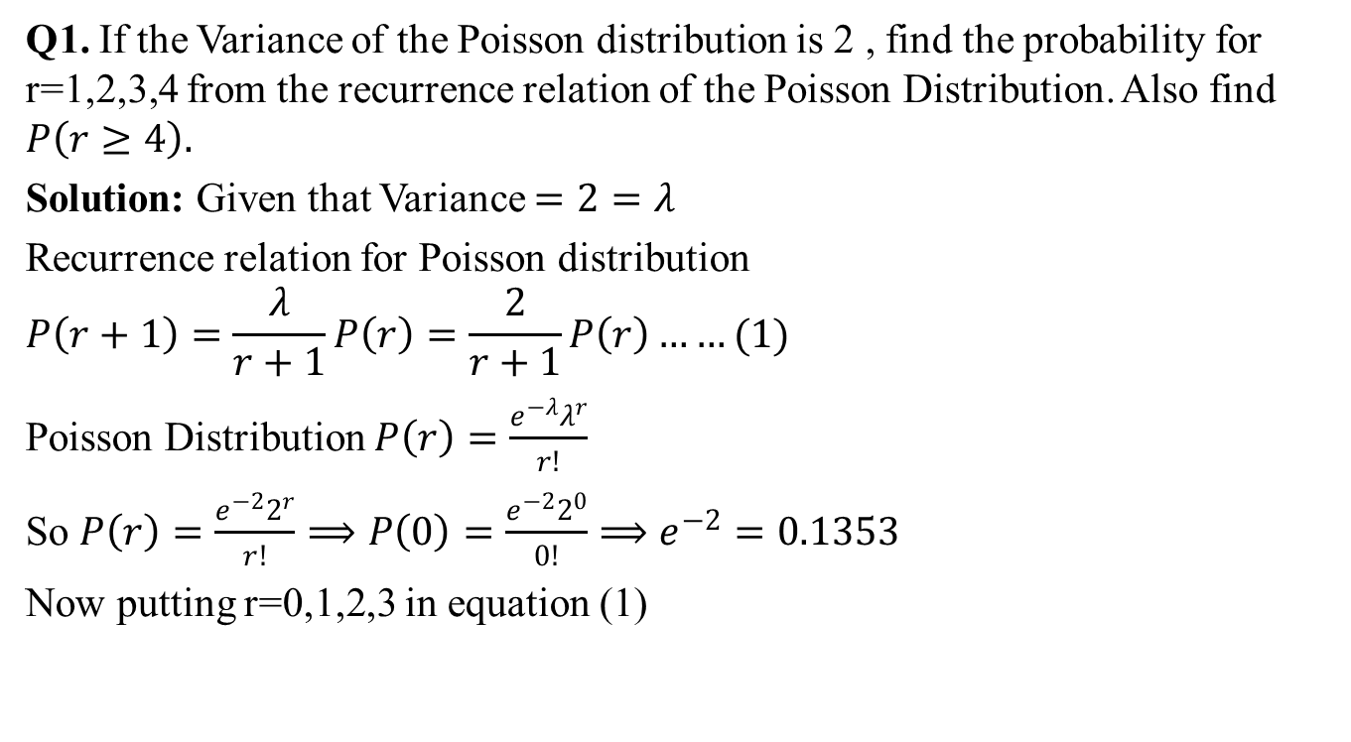
Problem based on Poisson
Distributions(CO4)
Q1. If the Variance of the Poisson distribution is 2 , find the probability for r=1,2,3,4 from the recurrence relation of the Poisson Distribution. Also find $P\left(r≥4\right).$
Solution: Given that Variance $=2=λ$
Recurrence relation for Poisson distribution
$$P\left(r+1\right)=\frac{λ}{r+1}P\left(r\right)=\frac{2}{r+1}P\left(r\right)……(1)$$
Poisson Distribution $P\left(r\right)=\frac{e^{−λ}λ^{r}}{r!}$
So $P\left(r\right)=\frac{e^{−2}2^{r}}{r!}⟹P\left(0\right)=\frac{e^{−2}2^{0}}{0!}⟹e^{−2}=0.1353$
Now putting r=0,1,2,3 in equation (1)

Slide 66
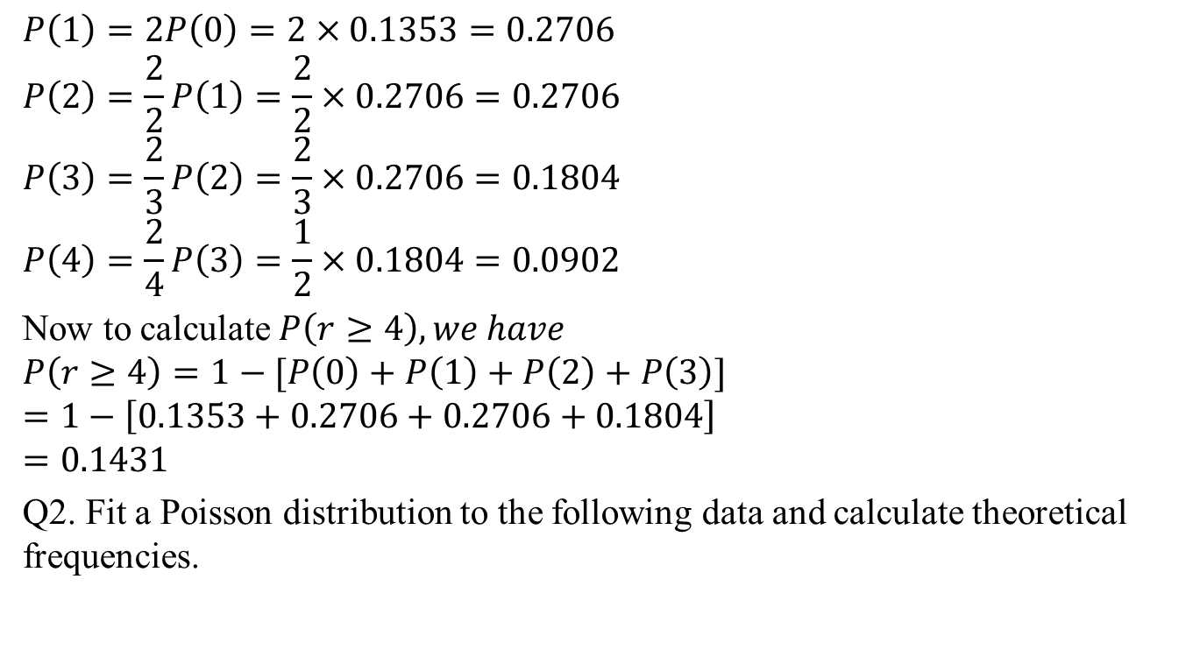
Cont…(CO4)
$$P\left(1\right)=2P\left(0\right)=2×0.1353=0.2706$$
$$P\left(2\right)=\frac{2}{2}P\left(1\right)=\frac{2}{2}×0.2706=0.2706$$
$$P\left(3\right)=\frac{2}{3}P\left(2\right)=\frac{2}{3}×0.2706=0.1804$$
$$P\left(4\right)=\frac{2}{4}P\left(3\right)=\frac{1}{2}×0.1804=0.0902$$
Now to calculate $P\left(r≥4\right), we have$
$$P\left(r≥4\right)=1−[P\left(0\right)+P\left(1\right)+P\left(2\right)+P\left(3\right)]$$
$$=1−\left[0.1353+0.2706+0.2706+0.1804\right]$$
$$=0.1431$$
Q2. Fit a Poisson distribution to the following data and calculate theoretical frequencies.

Slide 67
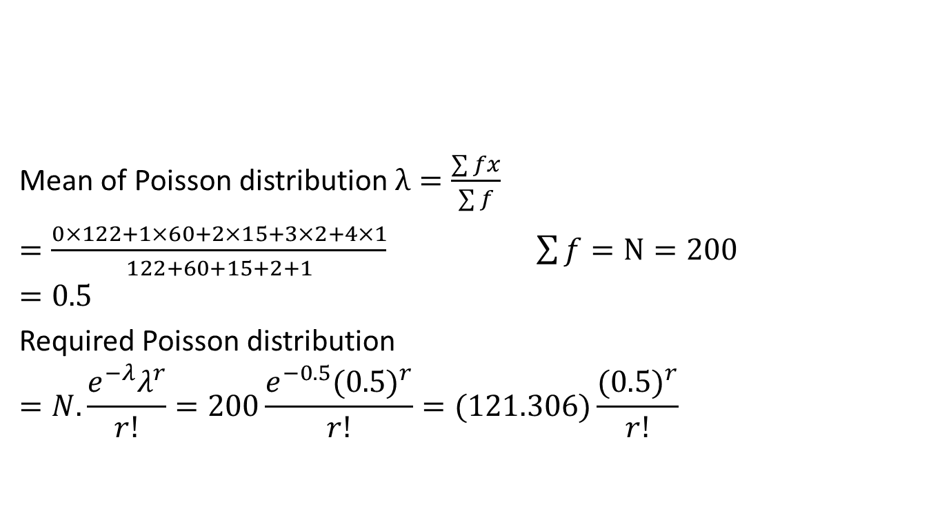
Cont…(CO4)
Mean of Poisson distribution $λ=\frac{\sum{fx}}{\sum{f}}$
$$=\frac{0×122+1×60+2×15+3×2+4×1}{122+60+15+2+1}\sum{f}=N=200$$
$$=0.5$$
Required Poisson distribution
$$=N.\frac{e^{−λ}λ^{r}}{r!}=200\frac{e^{−0.5}{(0.5)}^{r}}{r!}=(121.306)\frac{({0.5)}^{r}}{r!}$$
Deaths: | 0 | 1 | 2 | 3 | 4
Frequencies | 122 | 60 | 15 | 2 | 1

Slide 68
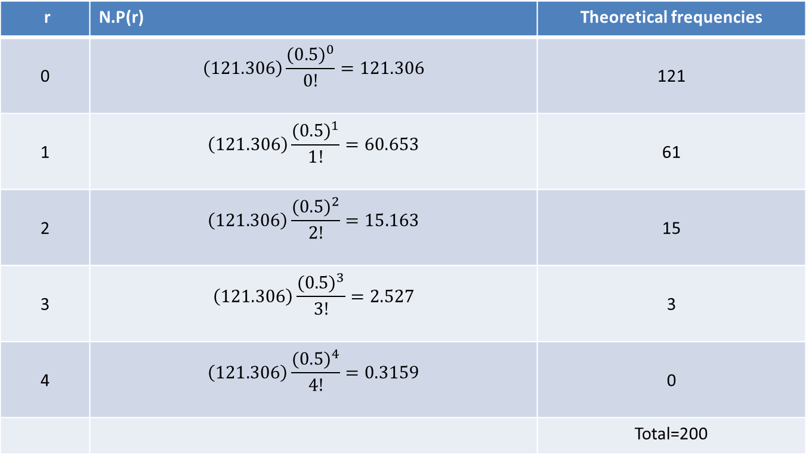
Cont…(CO4)
r | N.P(r) | Theoretical frequencies
0 | $$\left(121.306\right)\frac{({0.5)}^{0}}{0!}=121.306$$ | 121
1 | $$\left(121.306\right)\frac{({0.5)}^{1}}{1!}=60.653$$ | 61
2 | $$\left(121.306\right)\frac{({0.5)}^{2}}{2!}=15.163$$ | 15
3 | $$\left(121.306\right)\frac{({0.5)}^{3}}{3!}=2.527$$ | 3
4 | $$\left(121.306\right)\frac{({0.5)}^{4}}{4!}=0.3159$$ | 0
 |  | Total=200

Slide 69
Recap (CO4)
Mathematical expectation
Mean
Variance
Moment Generating Function
Binomial distribution
Poisson distribution

Slide 70
Topic objective of Normal Distribution(CO4)
To define the probability density function of a normal random variable.
To learn the characteristics of a typical normal curve.
To explore the key properties, such as the moment-generating function, mean and variance, of a normal random variable.

Slide 71
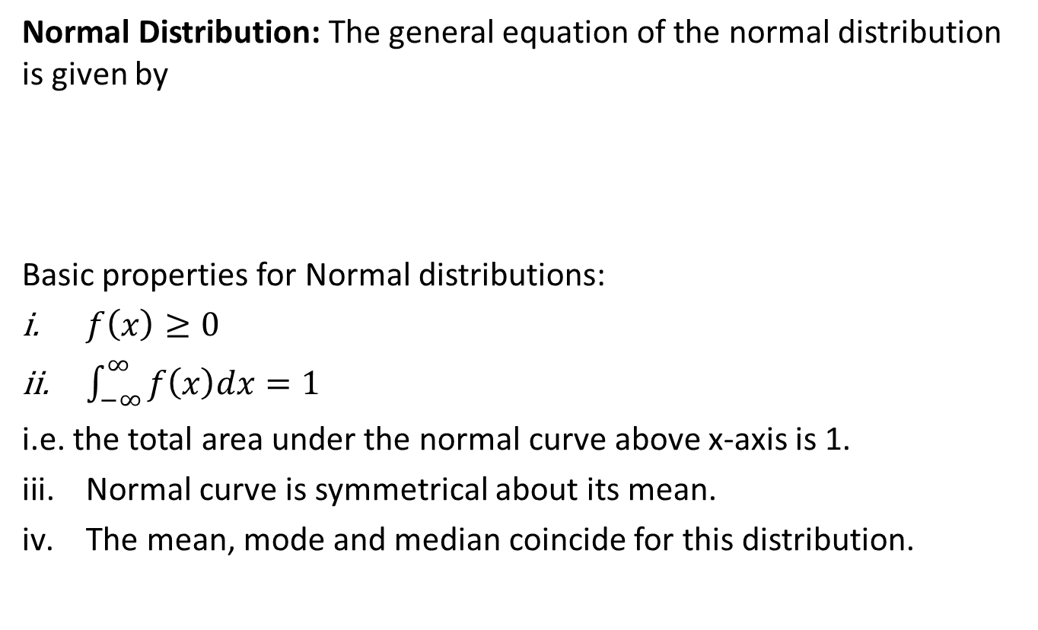

Normal Distribution(CO4)
Normal Distribution: The general equation of the normal distribution is given by
Basic properties for Normal distributions:
$f\left(x\right)≥0$
$\int_{−∞}^{∞}{f\left(x\right)dx=1}$
i.e. the total area under the normal curve above x-axis is 1.
Normal curve is symmetrical about its mean.
The mean, mode and median coincide for this distribution.
$$f\left(x\right)=\frac{1}{σ\sqrt{2π}}e^{−\frac{1}{2}{\left(\frac{x−μ}{σ}\right)}^{2}}$$

Slide 72
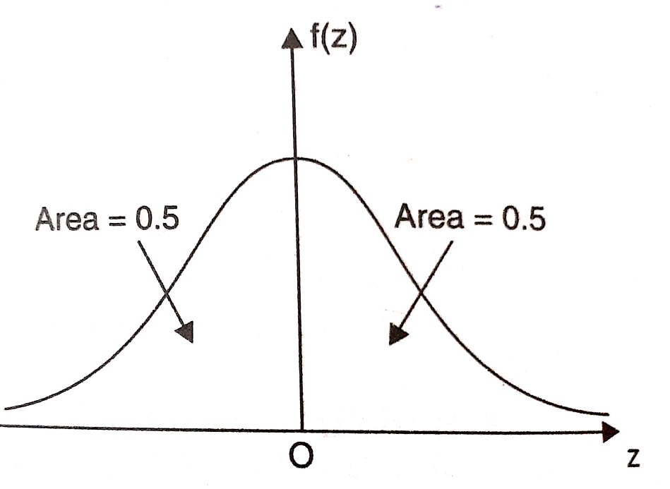
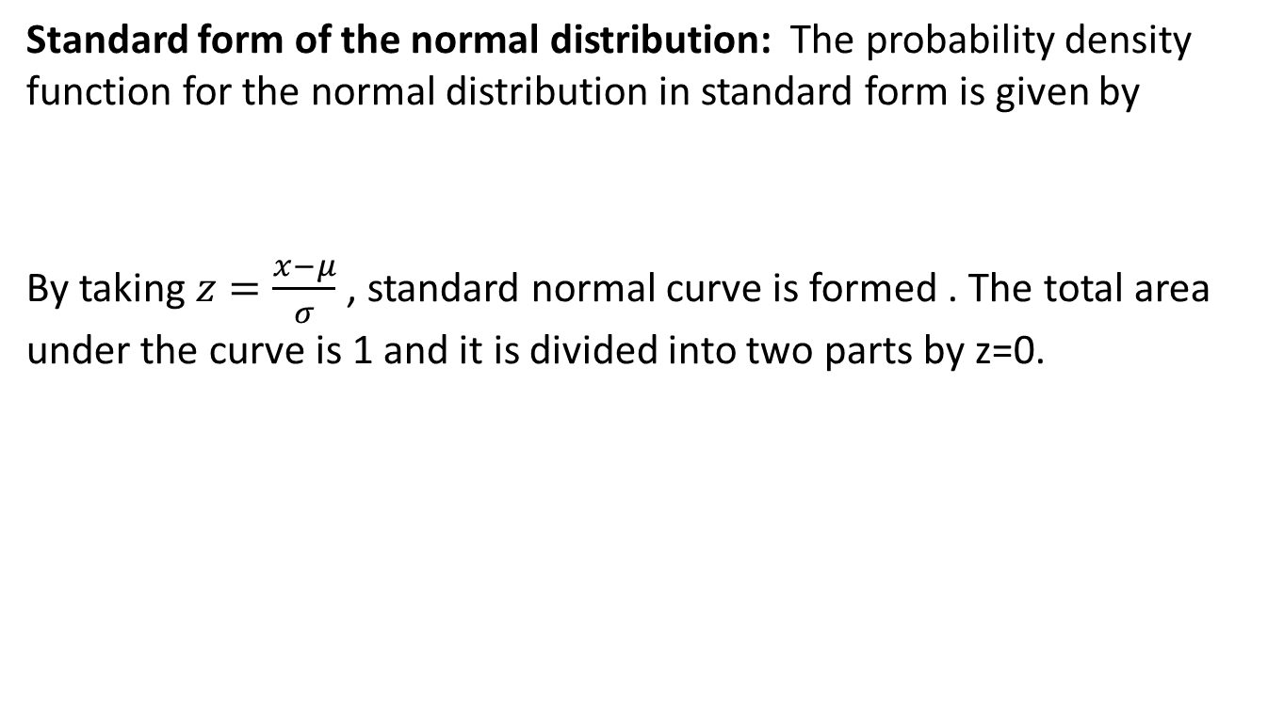

Cont…(CO4)
Standard form of the normal distribution: The probability density function for the normal distribution in standard form is given by
By taking $z=\frac{x−μ}{σ}$ , standard normal curve is formed . The total area under the curve is 1 and it is divided into two parts by z=0.
$$f\left(z\right)=\frac{1}{\sqrt{2π}}e^{−\frac{1}{2}z^{2}}$$

Slide 73
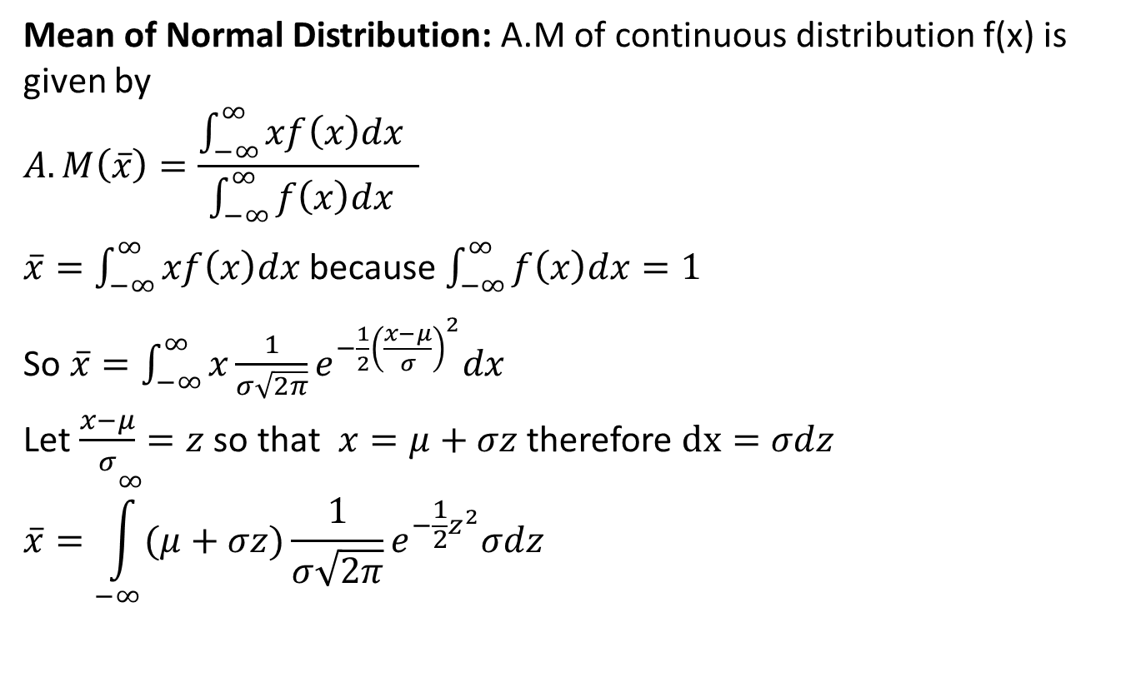
Mean and Variance of Normal
distribution(CO4)
Mean of Normal Distribution: A.M of continuous distribution f(x) is given by
$$A.M\left(\overline{x}\right)=\frac{\int_{−∞}^{∞}{xf\left(x\right)dx} }{\int_{−∞}^{∞}{f\left(x\right)dx} }$$
$\overline{x}=\int_{−∞}^{∞}{xf\left(x\right)dx}$ because $\int_{−∞}^{∞}{f\left(x\right)dx=1}$
So $\overline{x}=\int_{−∞}^{∞}{x\frac{1}{σ\sqrt{2π}}e^{−\frac{1}{2}{\left(\frac{x−μ}{σ}\right)}^{2}}dx}$
Let $\frac{x−μ}{σ}=z$ so that $x=μ+σz$ therefore $dx=σdz$
$$\overline{x}=\int_{−∞}^{∞}{(μ+σz)\frac{1}{σ\sqrt{2π}}e^{−\frac{1}{2}z^{2}}σdz}$$
KMB-104 Unit-3

Slide 74
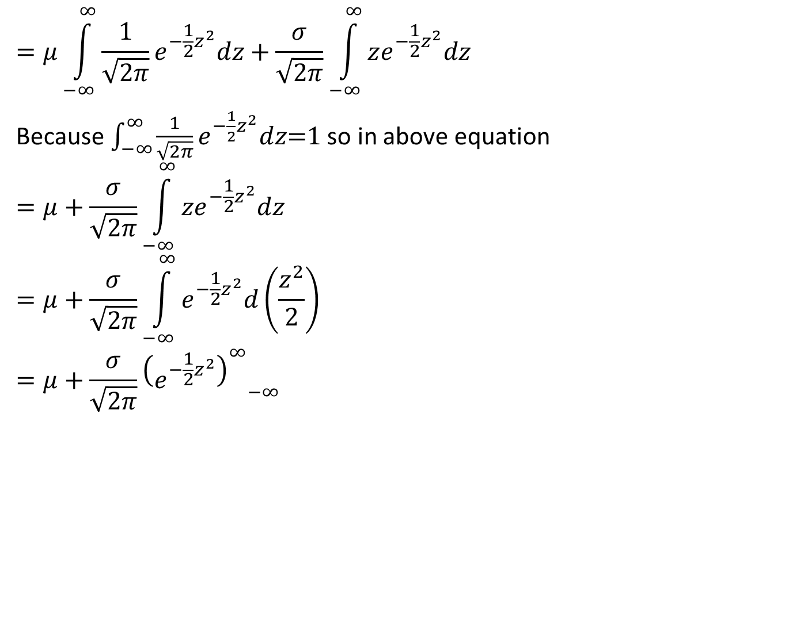
Cont…(CO4)
$$=μ\int_{−∞}^{∞}{\frac{1}{\sqrt{2π}}e^{−\frac{1}{2}z^{2}}dz+\frac{σ}{\sqrt{2π}}\int_{−∞}^{∞}{ze^{−\frac{1}{2}z^{2}}dz} }$$
Because $\int_{−∞}^{∞}{\frac{1}{\sqrt{2π}}e^{−\frac{1}{2}z^{2}}dz\text{=1} }$so in above equation
$$=μ+\frac{σ}{\sqrt{2π}}\int_{−∞}^{∞}{ze^{−\frac{1}{2}z^{2}}dz}$$
$$=μ+\frac{σ}{\sqrt{2π}}\int_{−∞}^{∞}{e^{−\frac{1}{2}z^{2}}d\left(\frac{z^{2}}{2}\right)}$$
$$=μ+\frac{σ}{\sqrt{2π}}{{\left(e^{−\frac{1}{2}z^{2}}\right)}_{}^{∞}}_{−∞}$$

Slide 75
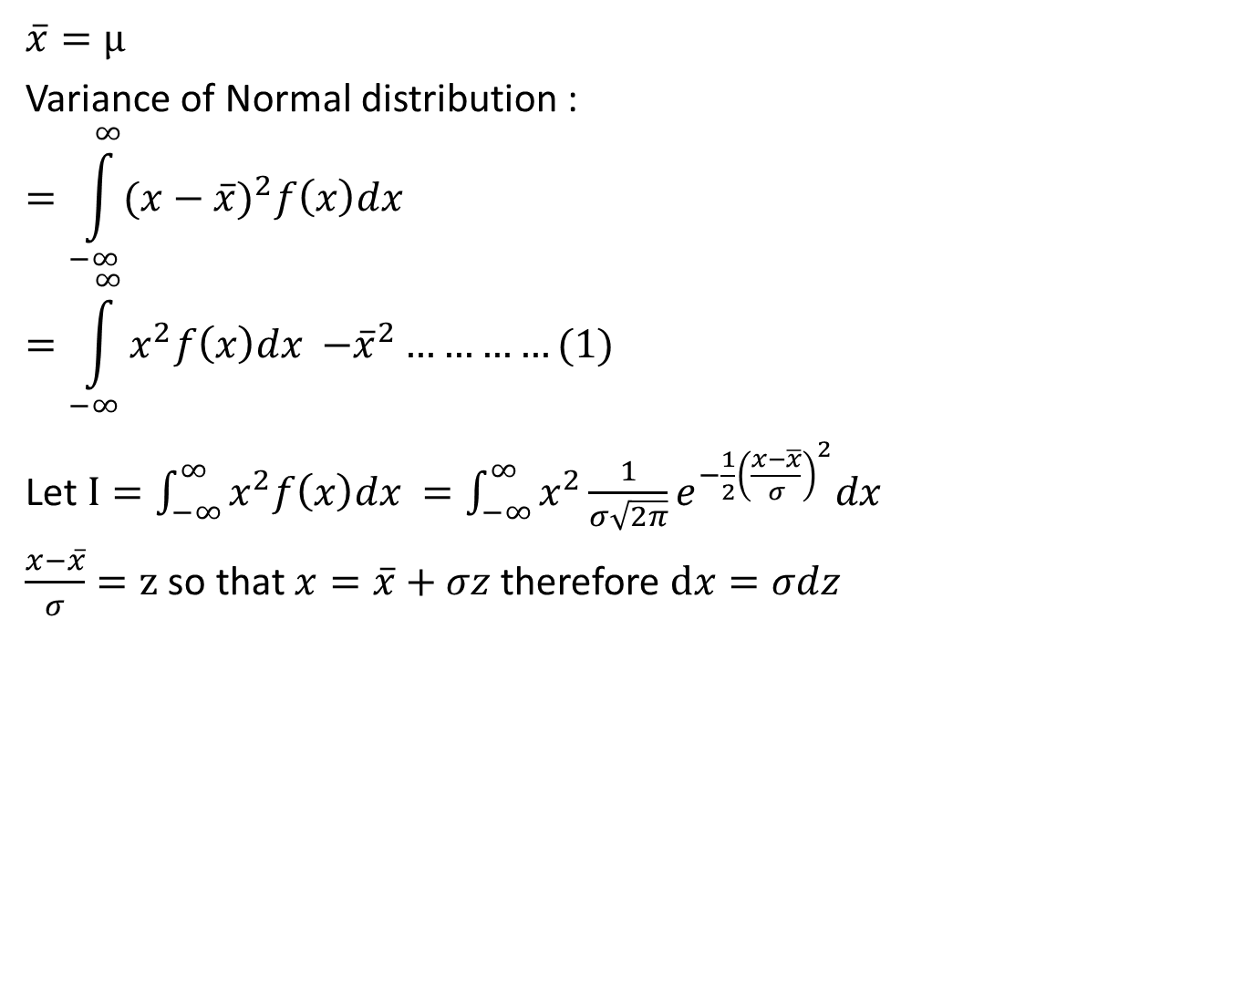
Cont…(CO4)
$$\overline{x}=μ$$
Variance of Normal distribution :
$$=\int_{−∞}^{∞}{{(x−\overline{x})}^{2}f\left(x\right)dx}$$
$$=\int_{−∞}^{∞}{x^{2}f\left(x\right)dx {−\overline{x}}^{2}}…………(1)$$
Let $I=\int_{−∞}^{∞}{x^{2}f\left(x\right)dx =\int_{−∞}^{∞}{x^{2}}\frac{1}{σ\sqrt{2π}}e^{−\frac{1}{2}{\left(\frac{x−\overline{x}}{σ}\right)}^{2}}dx}$
$\frac{x−\overline{x}}{σ}=z$ so that$x=\overline{x}+σz$therefore $dx=σdz$

Slide 76
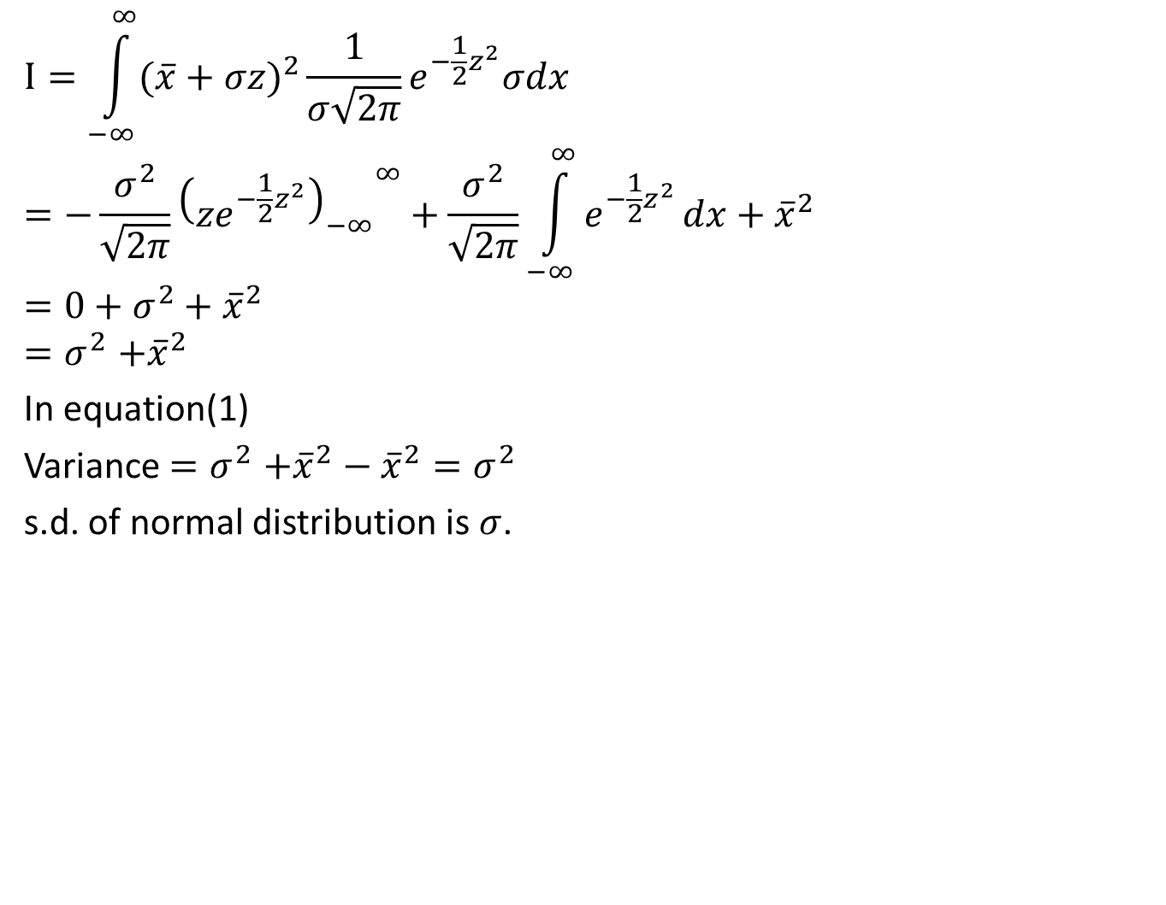
Cont... (CO4)
$$I=\int_{−∞}^{∞}{{(\overline{x}+σz)}^{2}}\frac{1}{σ\sqrt{2π}}e^{−\frac{1}{2}z^{2}}σdx$$
$$=−\frac{σ^{2}}{\sqrt{2π}}{{\left(ze^{−\frac{1}{2}z^{2}}\right)}_{−∞}}^{∞}+\frac{σ^{2}}{\sqrt{2π}}\int_{−∞}^{∞}{e^{−\frac{1}{2}z^{2}}}dx+{\overline{x}}^{2}$$
$$=0+σ^{2}+{\overline{x}}^{2}$$
$${=σ}^{2}+{\overline{x}}^{2}$$
In equation(1)
Variance ${=σ}^{2}+{\overline{x}}^{2}−{\overline{x}}^{2}=σ^{2}$
s.d. of normal distribution is $σ$.

Slide 77
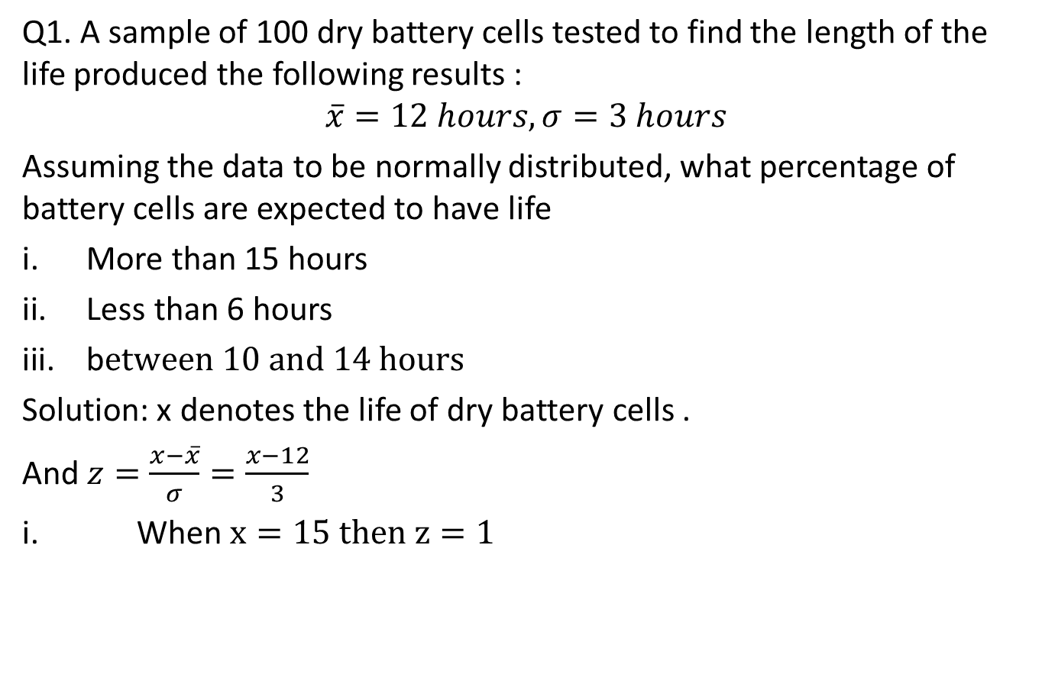
Problem based on Normal
distribution(CO4)
Q1. A sample of 100 dry battery cells tested to find the length of the life produced the following results :
$$\overline{x}=12 hours, σ=3 hours$$
Assuming the data to be normally distributed, what percentage of battery cells are expected to have life
More than 15 hours
Less than 6 hours
b$etween 10 and 14 hours$
Solution: x denotes the life of dry battery cells .
And $z=\frac{x−\overline{x}}{σ}=\frac{x−12}{3}$
i. When $x=15 then z=1$

Slide 78
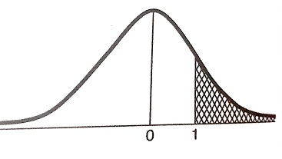
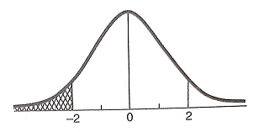
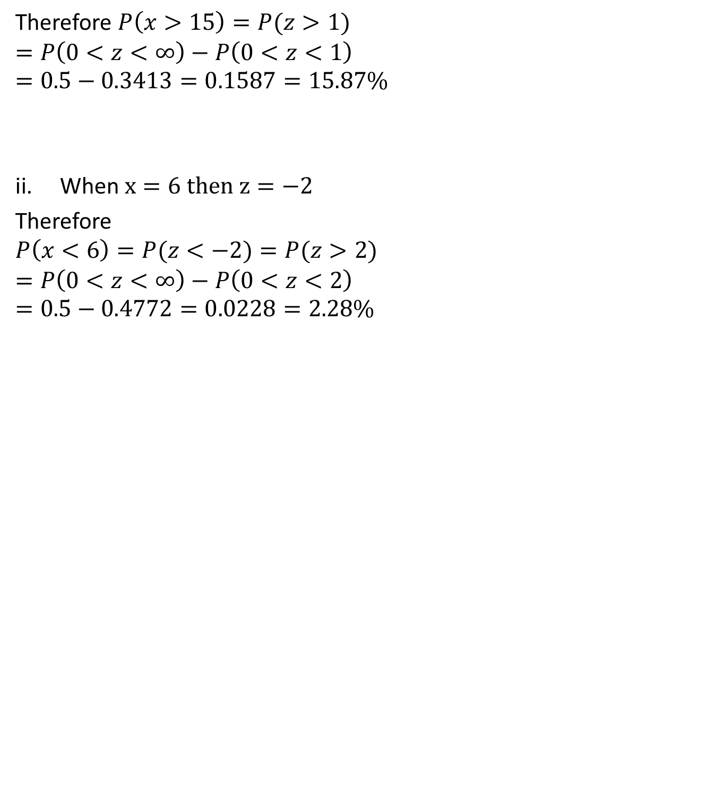
Cont…(CO4)
Therefore $P\left(x>15\right)=P(z>1)$
$$=P\left(0<z<∞\right)−P\left(0<z<1\right)$$
$$=0.5−0.3413=0.1587=15.87\%$$
When $x=6 then z=−2$
Therefore
$$P\left(x<6\right)=P(z<−2)=P(z>2)$$
$$=P\left(0<z<∞\right)−P\left(0<z<2\right)$$
$$=0.5−0.4772=0.0228=2.28\%$$

Slide 79
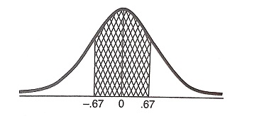

Cont…(CO4)
When $x=10 then z=−0.67$
$$when x=14 then z=0.67$$
$$P\left(10<x<14\right)=P\left(−0.67<z<\right).67)$$
$$=2P\left(0<z<0.67\right)=2×0.2485=49.70\%$$

Slide 80

Daily Quiz(CO4)
1. In a distribution exactly Normal, 31% of the items are under 45 and 8% are over 64. What are the mean and Standard deviation of this Distribution? It is given that if
$f\left(t\right)=\frac{1}{\sqrt{2π}}\int_{0}^{t}{e^{\frac{{−x}^{2}}{2}}dx}$ then $f\left(0.5\right)=0.19, f\left(1.4\right)=0.42.$

Slide 81
Recap(CO4)
Mathematical expectation
Mean
Variance
Moment Generating Function
Binomial distribution
Poisson distribution
Normal Distributions

Slide 82

Exponential Distribution(CO4)
Exponential distribution:
A continuous random variable $X=x$ which has the following Pdf
$f\left(x\right)=\left\{\begin{aligned}λe^{−λx} for x≥0 \\ 0 for x<0\end{aligned}\right.$
Where $λ$ is a parameter.
is called exponential distribution.
Mean of Exponential distribution: We know that mean is given by
Mean = $E\left(X=x\right)=\int_{−∞}^{∞}{xf\left(x\right)dx}$
$=\int_{0}^{∞}{xλe^{−λx} dx}$
$=λ\int_{0}^{∞}{xe^{−λx} dx}$

Slide 83

Exponential Distribution(CO4)
$=λ\int_{0}^{∞}{x^{2−1}} e^{−λx} dx$, which is a Gamma function
$=λ\frac{Γ2}{λ^{2}}=\frac{1}{λ}$
$\left[Mean=\frac{1}{λ}\right]$
Variance of Exponential distribution:
We know that the variance is given by
Variance$\left(X=x\right)=E\left(x^{2}\right)−{\left(E(x)\right)}^{2}$ ……….(1)
Now $E\left(x^{2}\right)=\int_{−∞}^{∞}{x^{2}f\left(x\right)dx}$
$=\int_{0}^{∞}{x^{2}λe^{−λx} dx}$
$=λ\int_{0}^{∞}{x^{3−1}e^{−λx} dx }$, which is a Gamma function
$=λ\frac{Γ3}{λ^{3}}=\frac{2}{λ^{2}}$

Slide 84

Exponential Distribution(CO4)
From (1), Variance$\left(x\right)=E\left(x^{2}\right)−{\left[E(x)\right]}^{2}$
$V\left(x\right)= \frac{2}{λ^{2}}−{\left[\frac{1}{λ}\right]}^{2}= \frac{1}{λ^{2}}$
Hence Variance$\left(x\right)=\frac{1}{λ^{2}}$
Q1. The length of Telephone conversation is an exponential variate with mean 3minutes. Find the Probability that call
(a) End in less than 3 minutes.
(b) tabes between 3 to 5 minutes.
Solution. Given, Mean$=3=\frac{1}{λ}$
$⇒λ=\frac{1}{3}$
$P\left(x<3\right)=\int_{0}^{3}{f\left(x\right)dx}=\int_{0}^{3}{λe^{−λx} dx}=\int_{0}^{3}{\frac{1}{3}e^{−x/3}dx}$

Slide 85

Exponential Distribution(CO4)
$$=\frac{1}{3}{\left[\frac{e^{{−x}/3}}{{−1}/3}\right]}_{0}^{3}=−\left(e^{−1}−e^{−0}\right)=1−\frac{1}{e}$$
$P\left(3<x<5\right)=\int_{3}^{5}{f\left(x\right)dx=\int_{3}^{5}{λe^{−λx}dx}}$
$=\frac{1}{3}\int_{3}^{5}{e^{−x/3}dx}=\frac{1}{3}{\left[\frac{{−x}/3}{{−1}/3}\right]}_{3}^{5}=−\left[e^{−5/3}−e^{−1}\right]$
$=\frac{1}{e}−\frac{1}{e^{5/3}}$

Slide 86
Daily Quiz(CO4)
Q1. The length of Telephone conversation is an exponential variate with mean 7 minutes. Find the Probability that call
(a) End in less than 7 minutes.
(b) tabels between 7 to 10 minutes.

Slide 87
Weekly Assignment(CO4)
Q1. The length of Telephone conversation is an exponential variate with mean 5 minutes. Find the Probability that call
(a) End in less than 5 minutes.
(b) tabels between 5 to 10 minutes.
Q2. The experience shows that 4 accidents occur in a plant on an average per month. Calculate the probabilities of less than 3 accidents in a certain month. Use Poisson distribution. (Given e⁻⁴=0.01832).
Q3. Net profit of 400 companies is normally distributed with a mean profit of Rs. 150 lakhs and a standard deviation of Rs. 20 lakhs. Find the number of companies whose profits(Rs. Lakhs ) are between 100 and 138.Also find the minimum profit of top 15% companies. (Area for Z=2.5 ,0.35 and 0.6 are 0.4938,1.04 and 0.2251)

Slide 88

Weekly Assignment(CO4)
Q4. In a sample of 1000 cases, the mean of a certain test is 14 and standard deviation is 2.5. Assuming distribution to be normal find
How many students score between 12 and 15?
How many score above 18?
How many score below 8?
How many score 16?
Given that $φ\left(z\right)=\frac{1}{\sqrt{2π}}\int_{0}^{z}{e^{−{z^{2}}/2}dz}, φ\left(0.4\right)=0.155,φ\left(0.8\right)=0.2881,φ\left(1.6\right)=0.445,φ\left(0.6\right)=0.0225,φ\left(1\right)=0.341$).
Q5. A large number of measurement is normally distributed with a mean 65.5 inches and S.D. of 6.2 inches. Find the percentage of measurement that fall between 54.8 inches and 68.8 inches. Given that area (at z = 1.73) = 0.4582 and area (at z = .53) = 0.2019 .

Slide 89

Weekly Assignment(CO4)
Q6. In a distribution exactly Normal, 31% of the items are under 45 and 8% are over 64. What are the mean and Standard deviation of this Distribution? It is given that if $f\left(t\right)=\frac{1}{\sqrt{2π}}\int_{0}^{t}{e^{\frac{{−x}^{2}}{2}}dx}$then $f\left(0.5\right)=0.19, f\left(1.4\right)=0.42$
Q7. The life of army shoes is normally distributed with mean 8 months and standard deviation 2 months.If 5000 airs are insured, how many pairs would you expected to need replacement after 12 months?
Q8. Find the mean and variance of the Binomial, Poisson and Normal distribution.

Slide 90

Weekly Assignment(CO4)
Q9.The probability that a pen manufactured by a company will be defective is $1/{10}.$ If 12 such pens are manufactured, find the probability that
Exactly two will be defective
At least two will be defective
None will be defective.
Q10.It is given that 2% of the electric bulbs manufactured by a company are defective. Using Poisson distribution find the probability that a sample of 200 bulbs will contain
No defective bulb
Two defective bulbs
Atmost three defective bulbs.

Slide 91
Weekly Assignment(CO4)
Q11.In a test on 2000 electric bulbs,it was found that the life of a particular make, was normally distributed with an average life of 2040 hours and S.D. of 60 hours, estimate the number of bulbs likely to burn for
More than 2150 hours
Less than 1950 hours
More than 1920 hours but less than 2160 hours
Q12.In a distribution exactly Normal, 7% of the items are under 35 and 89% are under 63. What are the mean and Standard deviation of this Distribution?

Slide 92
Faculty Video Links, Youtube & NPTEL Video Links and Online Courses Details
Self made Video Link:
https://youtu.be/6pZXCcoeYiU
https://youtu.be/izT2QpldbnU
https://youtu.be/UaLNsZQK8fo
Suggested Video inks:
https://youtu.be/L3wQw0wva3g
https://youtu.be/n9qpktdFfLU
https://youtu.be/_Qlxt0HmuOo
https://youtu.be/YSwmpAmLV2s
https://youtu.be/KLnGOL_AUgA
https://youtu.be/cQp_bJdxjWw
https://youtu.be/geB0A7CPGaQ
https://youtu.be/zmyh7nCjmsg
https://youtu.be/ohquDY3fZqk
https://youtu.be/izGZLnB-mEo
https://youtu.be/q48uKU_KWas

Slide 93

MCQ s(CO4)
Q1. Suppose that a random variable $x$ has normal distribution with mean 9 and variance 9. Then the value of $c$ such that $P\left(x>c\right)=0.16$ is-(Given that $φ\left(1\right)=0.34$ )
12
1
10
None of these
Q2 .The life of army shoes is normally distributed with mean 8 months and standard deviation 2 months. If 5000 pairs are issued, how many pairs would be expected to need replacement after 12 months are-(Given that $P\left(z≥2\right)=0.228$)
114
4886
115
4890

Slide 94

MCQ s(CO4)
$\frac{100}{3}$
$\frac{200}{3}$
$\frac{50}{3}$
None of these
Q3. Suppose that a book of 600 pages contains 40 printing mistakes. Assume that these errors are randomly distributed throughout the book and $x$, the number of errors per page has a Poisson distribution then what is probability that 10 pages selected at random will be free of errors
0.54
0.15
0.51
None of these

Slide 95

MCQ s(CO4)
Q4. The probability that a bomb dropped from a plane will strike the target is $\frac{1}{5}$. If six bombs are dropped then the probability that exactly two will strike the target is
0.345
0.145
0.245
None of these
Q5. For the standard normal variate $z$ mean and variance are-
0,1
$μ,σ^{2}$
1,0
$σ^{2},μ$

Slide 96
Glossary(CO4)
Q1. The distribution of the number of road accidents per day in a city is poisson with mean 4. find the number of days out of 100 days when there will be
No accident
At least two accident
At most three accident
Between two and five accident
Pick the correct option from glossary
91
43
39
2

Slide 97
Glossary(CO4)
Q2.In 800 families with 4 children each ,how many families would be expected to have
2 boys and 2 girls
No girl
At least one boy
At most two girls (Assume equal probabilities for boys and girls)
Pick the correct option from glossary
750
550
50
300

Slide 98
Old Question Papers
First Sessional Set-1 (CSE,IT,CS,ECE,IOT).docx
Second Sessional Set-2 (CSE,IT,CS,ECE,IOT).docx
Maths IV PUT.docx
Maths IV final paper_2022.pdf

Slide 99

University Expected question(CO4)
Q1. Find the mean and variance of the binomial distribution.
Q2. If the probability of hitting a target is 10% and 10 shots are fired independently. What is the probability that the target will be hit at least once?
Q3. If there are 3 misprints in a book of 1000 pages find the probability that a given page will contain
No misprint
More than 2 misprints
Q4. If the heights of 300 students are normally distributed with mean 64.5 inches and standard deviation 3.3 inches. Find the height below which 99% of the student lie.
(Given that $φ\left(z\right)=\frac{1}{\sqrt{2π}}\int_{0}^{z}{e^{−{z^{2}}/2}dz}, φ\left(2.327\right)=0.49$).

Slide 100
University Expected question(CO4)
Q7. The experience shows that 4 accidents occur in a plant on an average per month. Calculate the probabilities of less than 3 accidents in a certain month. Use Poisson distribution. (Given e⁻⁴=0.01832).
Q8. As a result of tests on 20,000 electric bulbs manufactured by a company it was found that the life time of a bulb was normally distributed with an average life of 2040 hours and standard deviation of 60 hours. On the basis of the information, estimate the number of bulbs that is expected to burn for
more than 2150 hours, and (ii) less than 1960 hours.
Q9. Write short note on
Binomial distribution
Poisson distribution
Q10. Show that mean of binomial distribution is np.

Slide 101
Unit Recap(CO4)
Students have taught the importance of the following topics….
With the concept of probability to evaluate probability distributions:
Mathematical expectation
Mean
Variance
Moment Generating Function
Binomial distribution
Poisson distribution
Exponential Distribution

Slide 102
References (CO4)
Introduction to Statistics - P.K. Giri & J. Banerjee.
Statistical Models: Theory and Practice by David Freedman.
Richard I. Levin, David S.Rubin “Statistics for Management”, Pearson Education
Anderson, Sweeney and Williams “Statistics for Business and Economics”, Cengage Learning.

Slide 103
Thank You

